Slide 1
Tracking threatened seabirds in the Namibian Islands’ Marine Protected Area (and beyond)
Jessica Kemper¹, Katrin Ludynia², Jean-Paul Roux³,
Rian Jones³, Richard B Sherley²
¹African Penguin Conservation Project, Namibia
²Dept. of Biological Sciences/Marine Research Institute, UCT, South Africa
³Ministry of Fisheries and Marine Resources, Namibia

Slide 2
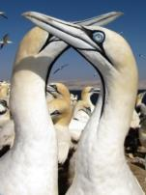
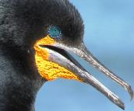
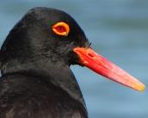
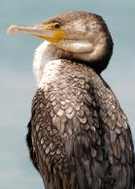
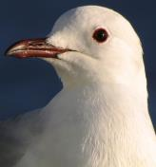
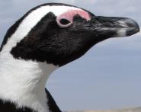
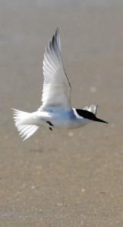
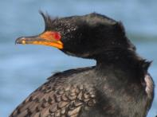
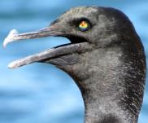
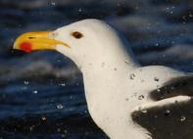
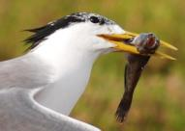
Eleven coastal seabird species regularly breed on Namibia’s coast
Eight of these species are listed as locally and/or globally THREATENED, including…

Slide 3
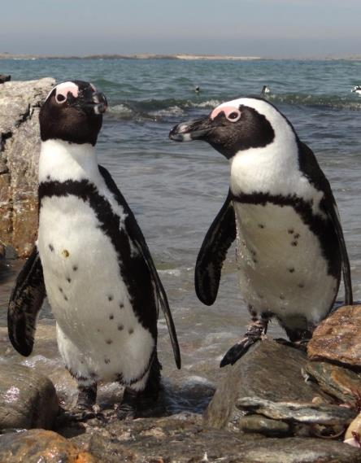
African Penguin
Globally and locally “ENDANGERED”
~25000 pairs, of which ~5800 pairs in Namibia (23% of global population)
Breeds at nine islands and two mainland sites in Namibia
Main threats:
Lack of quality food
Lack of quality breeding habitat
Disturbance
Oil pollution
Predation (seals, gulls)

Slide 4
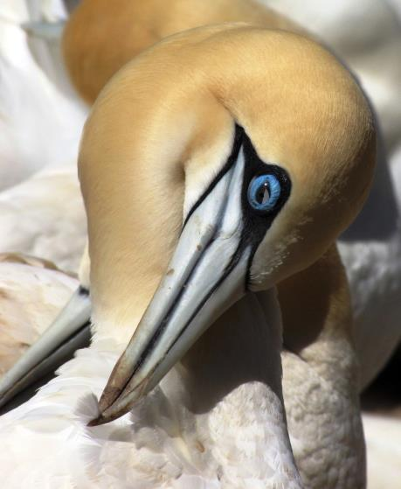
Cape Gannet
Locally “CRITICALLY ENDANGERED”
Globally “VULNERABLE”
~13000 pairs in Namibia (11% of global population)
Breeds at only six islands; three in SA, three in Namibia
Main threats:
Lack of (quality) food
Disturbance (guano harvest)
Oil pollution
Accidental bycatch in fisheries
Predation (seals)
Notes:
The latest IUCN assessment (two months ago) indicates that the species will probably be reclassified globally endangered in the next assessment (current global decrease is 49% over three generations).

Slide 5
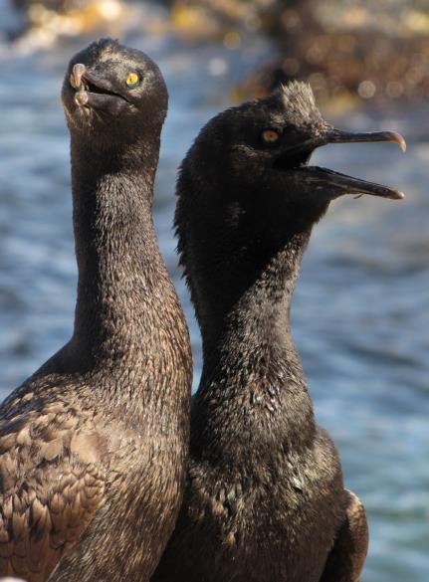
Bank Cormorant
Globally and locally “ENDANGERED”
Global population ~2500 pairs, of which ~2000 pairs on 3 ha Mercury Island
Main threats:
Disturbance
Limited breeding habitat
Oil pollution
Poor quality food
Displacement (Cape Cormorants, seals)
Notes:
An oil spill at Mercury Island could be catastrophic for the survival of the species

Slide 6
1. Tracking breeding coastal seabirds:
Where and how far away from the colony do they forage?
How hard to they have to work to feed their chick(s)?
Are there any specific foraging “hotspots” we should protect?
Notes:
TD refers to temperature-depth

Slide 7
African Penguins:
Using GPS Tdlog data loggers:
Devices made by earth&OCEAN technologies (expensive but reliable)
Records position at sea every 2-15 minutes, accuracy 10-20 m
Temperature and pressure sensors allow analysis of dive profiles, i.e. how often, how long, how deep birds dive during foraging trips
Device design evolving, getting smaller, lighter, more reliable and efficient
Notes:
TD refers to temperature-depth

Slide 8
Data loggers need to survive dives to 100 m water depth (sturdy, waterproof housing)
Battery life limited (~2-3 days, depending on settings); one or two foraging trips recorded per deployment
Bird needs to be re-caught to retrieve data

Slide 9
New design (since 2016)
Old design (2005 to 2015)

Slide 10
Catching a penguin by hand:
Unsuspecting candidate

Slide 11
Affixing the data logger by weaving a lattice of waterproof Tesa® tape into the feathers (no feather damage):

Slide 12
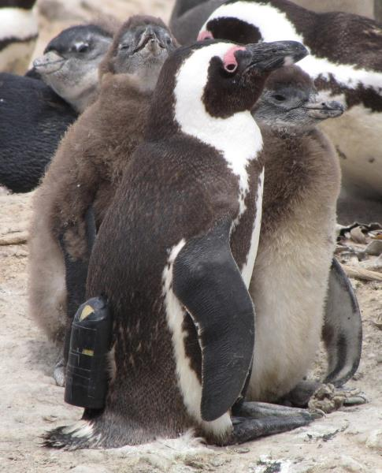
Penguin is returned to its nest (whole procedure takes about 10 minutes) Device is (ideally) collected after two to three days

Slide 13
Between 2005 and 2016:
 | Mercury | Halifax | Possession
No. successful deployments | 99 | 109 | 3
No. foraging tracks recorded | 101 | 165 | 4
No. field seasons | 8 | 10 | 1
Diet sampling studies done in conjunction with tracking during some field seasons
Only two devices have been lost

Slide 14
Cape Gannets:
Same devices, attached to tail feathers and lower back of breeding individuals
Different settings used to account for longer foraging trips and plunge dives
Number of GPS data logger deployments by three separate teams:
Mercury Island: 35 (2003, 2005, 2006)
Ichaboe Island: 226 (2003 to 2007)
Possession Island: 25 (2003)

Slide 15
Bank Cormorants:
Tracking done at Mercury Island during 2006, 2008 and 2010, using either:
MiniGPS loggers, giving positions at 1 sec intervals (5 individuals, 34 tracks), OR
Precis TD loggers to record diving data (21 individuals, 112 tracks)
Done only in colonies where birds are used to human presence, to minimise disturbance
Tracking was done in conjunction with diet sampling and nest observations

Slide 16
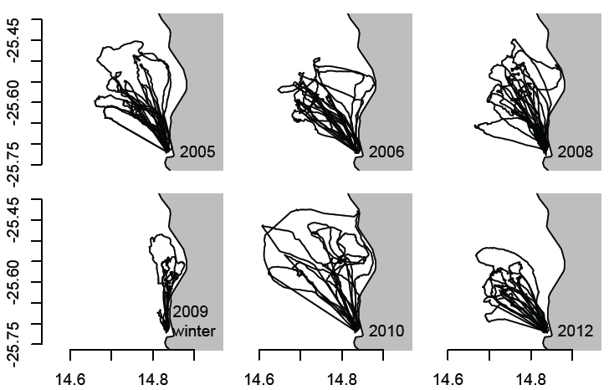
Some key findings:
African Penguins:
Some foraging hotspots identified (eg NW of Mercury Island)
Foraging effort differs between localities and between years / seasons
Foraging distance from the breeding colony is about 20 km
Mercury Island tracks (2005-2012)

Slide 17
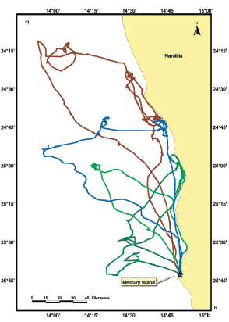
Some key findings:
Cape Gannets:
Birds from Mercury forage mostly inshore and to the north; those from Ichaboe further offshore and to the west
Birds travel up to 500 km during a single foraging trip, with an average trip duration of 24 hours
Birds travel up to ~120 km from a breeding locality

Slide 18
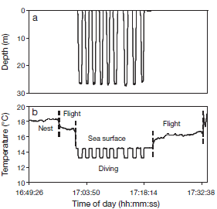
Some key findings:
Bank Cormorants:
Birds travel up to 8 km during a single foraging trip, and up to 4 km from the island
Foraging trips last less than one hour
Maximum recorded dive depth was 47.6 m
Individuals tend to revisit specific areas to forage
Example of an activity profile (Precis TD logger)

Slide 19
Designing the Namibian Islands’ Marine Protected Area (NIMPA)
Principal aim of the NIMPA is to protect:
breeding sites
key foraging areas/ranges
of Nambia’s threatened coastal seabirds

Slide 20
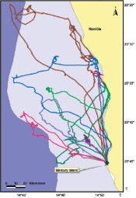
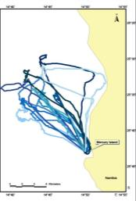
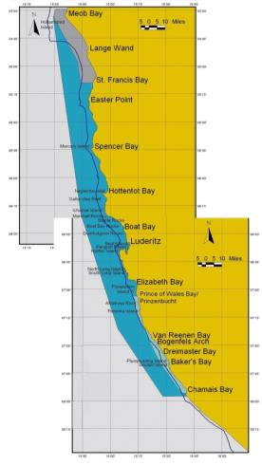
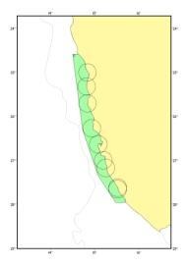
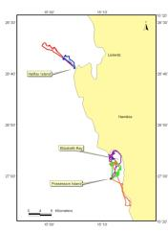
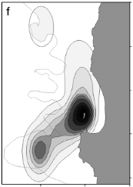
2005-2006 tracking data was crucial in the NIMPA’s design
Final MPA design (proclaimed 2009)
Tracking data
Initial MPA design
Notes:
Gannet tracks left top, penguin tracks from Mercury right top and Halifax/Possession left bottom, Bank Cormorants right bottom. Instead of having an MPA around each island, this was merged into one MPA. Perhaps mention that the NIMPA is 400 km by 30 km, giving about 1 million ha. It runs from Meob Bay to Chamais Bay and includes all natural seabird breeding islands and islets.

Slide 21
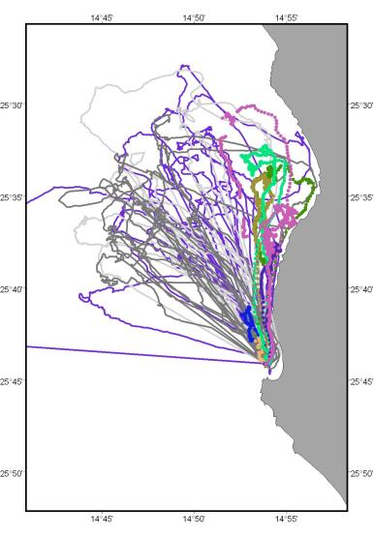
Subsequent GPS logger data of African Penguins, Cape Gannets and Bank Cormorants…
forms part of a long-term programme to monitor the efficacy of the NIMPA (see Ludynia et al. 2010, 2012)
provides baseline data to assess risks posed by current and/or future activities, e.g. inshore diamond mining in southern Namibia

Slide 22
2. Tracking non-breeding coastal seabirds

Slide 23
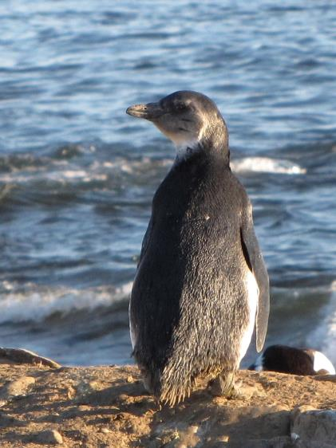
African Penguins
The first 12-18 months after fledging are spent at sea before returning to land to moult
First year survival is a crucial factor in population dynamics
Monitoring post-fledging movement is vital
Satellite technology allows long-term tracking
Collaborative project with South African researchers

Slide 24
Tracking five newly fledged penguins from Cape Town in 2011:
Feeding “hotspots” near Hondeklip Bay and south of Swakopmund
From: Sherley et al. 2013

Slide 25
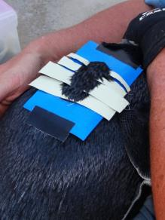
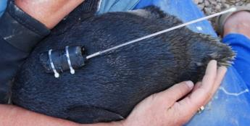
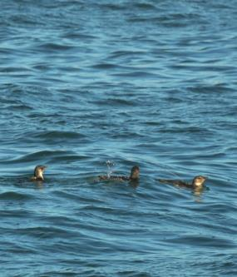
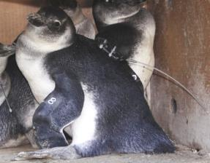
Expanding the study in 2013 to include ten fledglings from Halifax and Mercury islands
KiwiSat® (Sirtrack) PTTs
Attached to the back with Tesa tape, some glue and cable ties
Only top condition (> 3 kg) fledglings chosen

Slide 26
A key foraging area south of Swakopmund confirmed
Juveniles target areas of high primary productivity
Before the near-collapse of sardine stocks, these areas would have held high densities of sardine
Suggests that poor juvenile survival/recruitment may be due to them ending up in the wrong spot
From: Sherley et al. in review

Slide 27
Cape Gannets
Post-breeding gannets leave the island in April and return in September/October
Relatively little is known about their winter distribution

Slide 28
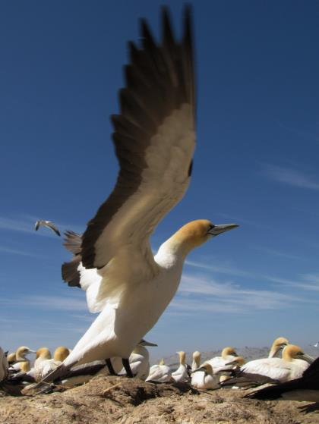
Using geolocator data loggers
Cheap, small and easy to attach to a gannet’s leg
Position data is calculated from light levels (only gives broad-scale indication of position)
Bird needs to be caught again to retrieve the device

Slide 29
Pilot project (2013)
20 chick-rearing gannets from Mercury Island and 8 birds from Ichaboe Island were equipped
16 devices from Mercury Island and none from Ichaboe Island were retrieved after winter
Analysis of collected data is ongoing (watch this space…)

Slide 30
Conclusions
Extremely valuable insights have been gained so far from tracking some of our threatened coastal seabirds
Tracking, particularly of African Penguins, continues
The growing time series can (and should) be used for
Marine spatial management planning
Conservation management
Fisheries management (EAF )

Slide 31
A big thank you to:
Shell Namibia Upstream BV
British Ornithologists’ Union
Percy Fitzpatrick Institute, UCT
Department of Environmental Affairs, SA
Seacode Research Group
MFMR
NACOMA
Namdeb
University of Kiel
CNRS
NNF
For further information
or publication reprints
contact me on
jkemper01@gmail.com

