Slide 1

Tracking to CHANGE
N/a’an ku sê Foundation
Dr. Rudie van Vuuren

Slide 2

Disclosure
Qualification : MB ChB – Stellenbosch

Slide 3
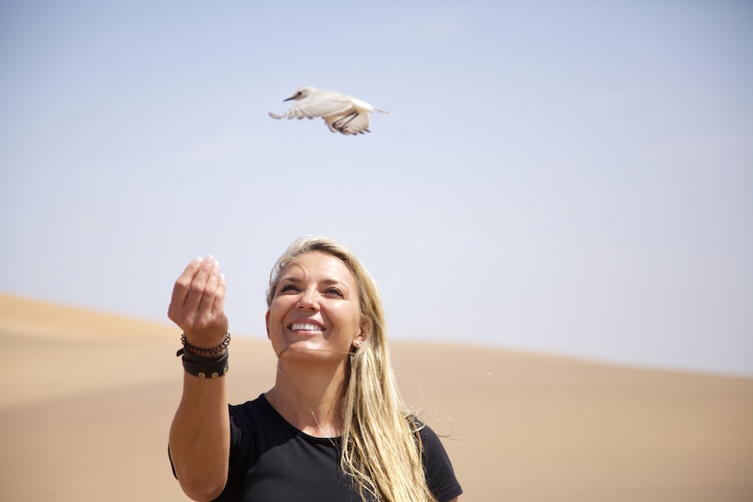
N/a’an ku sê
Wildlife Sanctuary situated 43 km east of Windhoek
Established in 2006

Slide 4
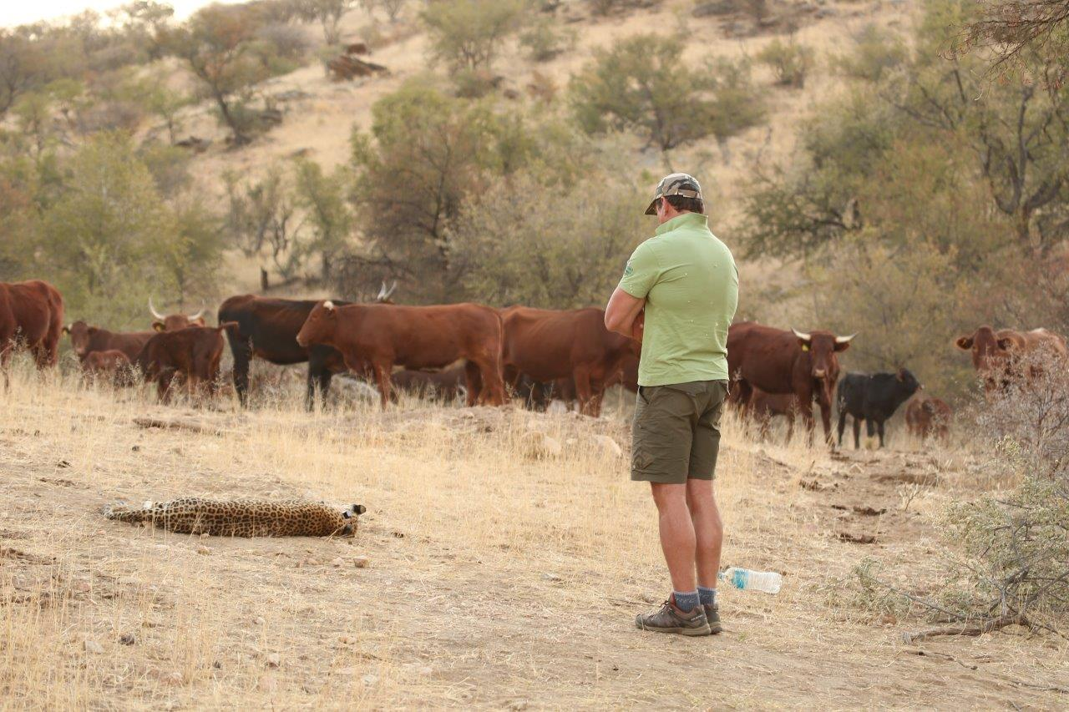
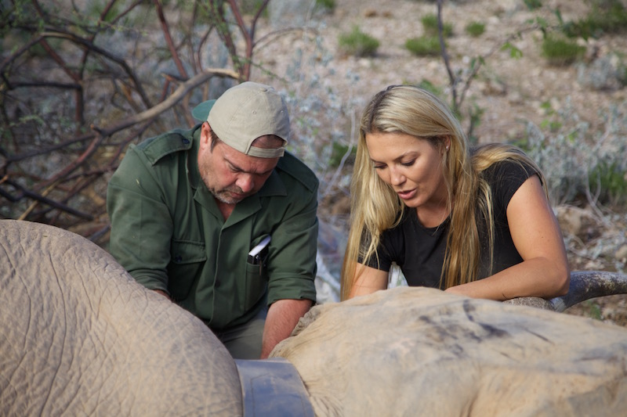
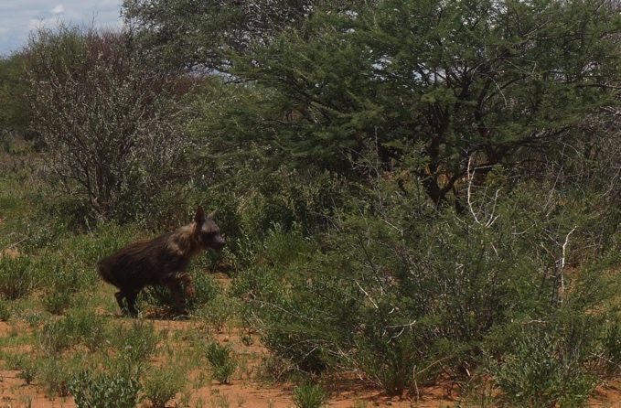
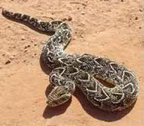
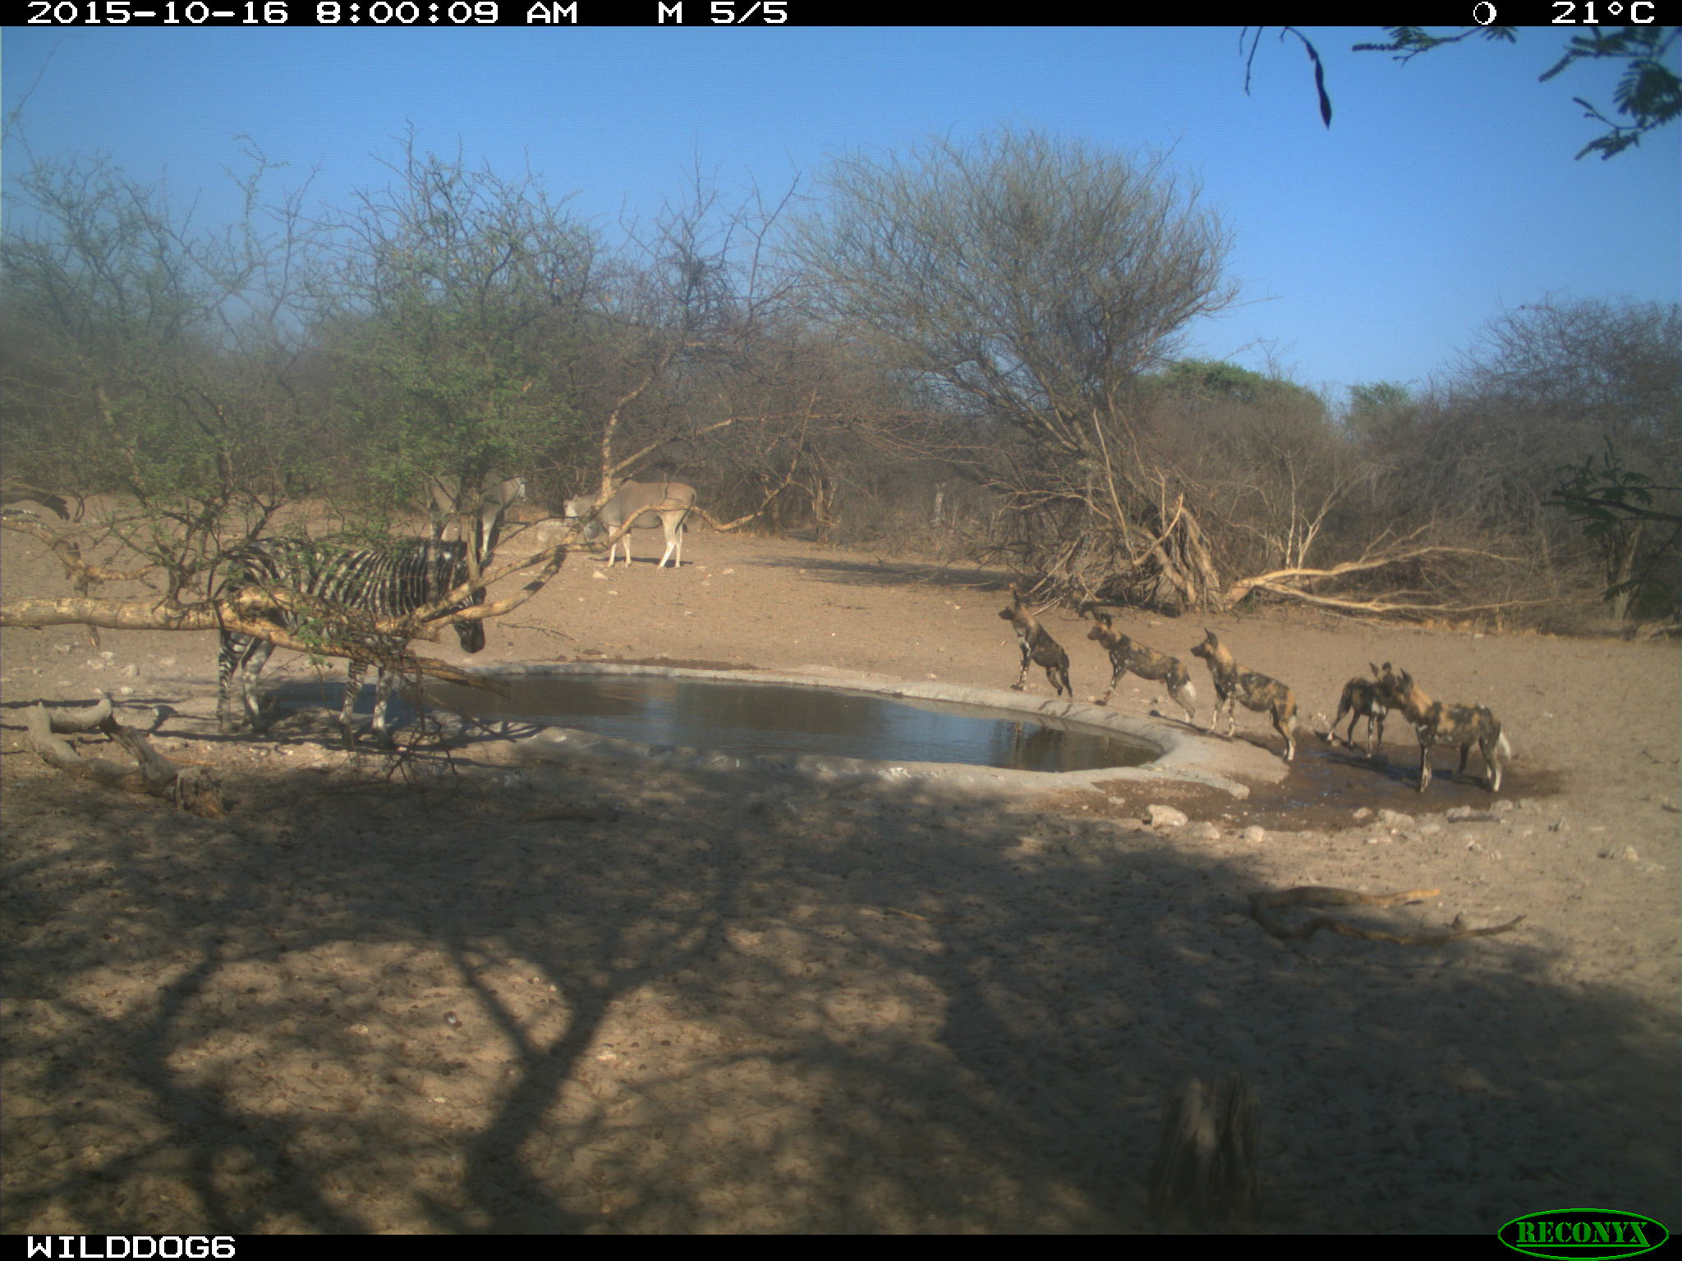
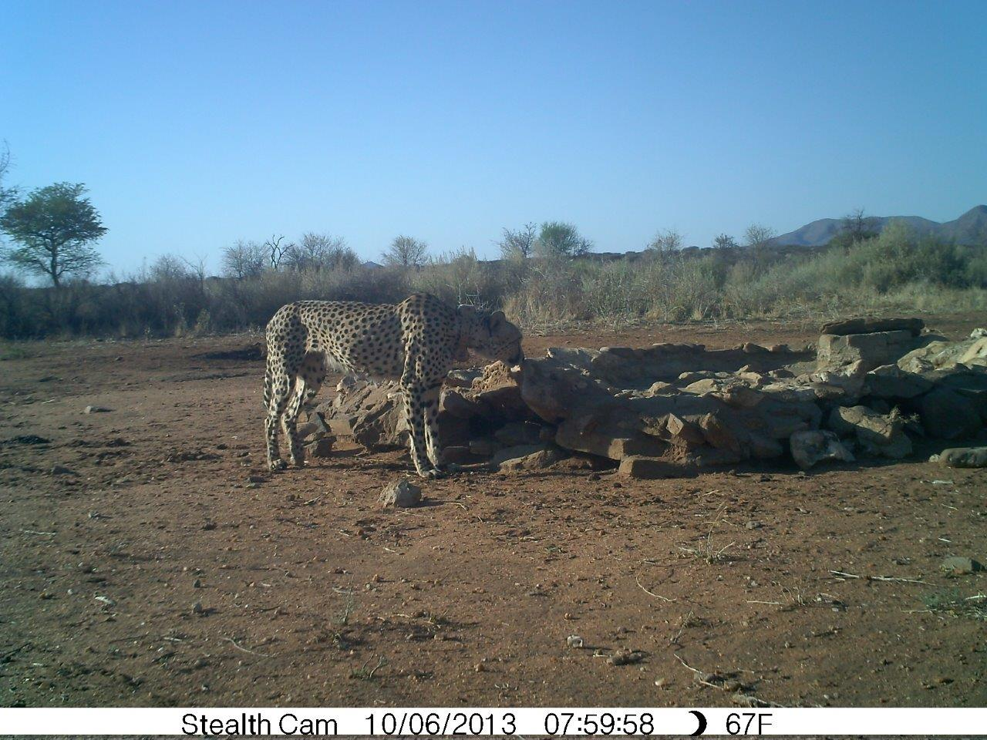
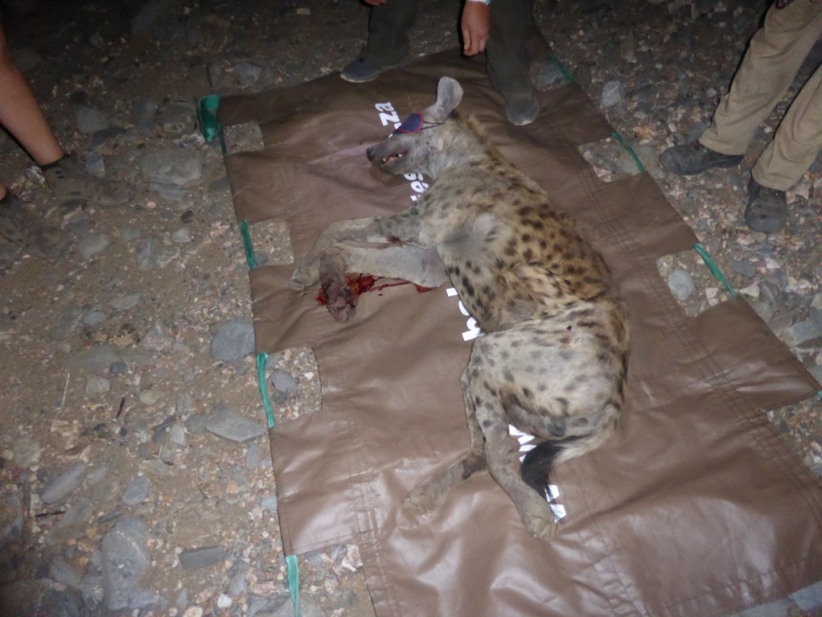

Slide 5
N/a’an ku sê Tracking devices
VHF devices: tracked with telemetry equipment
GPS collars: Iridium system
Drop off system + tracking with VHF used to retrieve collar
Data download: via online server (AWT) or sky-Q, or specific software
Suppliers used:
  African Wildlife Tracking: Robust, less expensive, but GPS runs as soon as manufactured
  Vectronics: not 100% reliable, get data every other day at best, more expensive, but can switch off GPS
  Sirtrack: reliable, expensive, can switch off GPS

Slide 6
Human – carnivore conflict N/a’an ku sê
Using GPS collars to keep carnivores in the wild
Situation faced:
  Indiscriminate killing of carnivore suspected of livestock predation
  Farmers want the carnivore suspected off of their property (either lethal or non-lethal removal): contact N/a’an ku sê for removal
Aim / purpose:
  Decrease lethal removal
  Decrease non-lethal removal
  Increase tolerance for carnivore
Methods:
  Identify true habitual livestock raider and target to remove only these, using GPS collars
  Promote livestock protection measures
  Help farmer with livestock management methods: identify carnivore hot spot with GPS data => avoid the area with herd

Slide 7
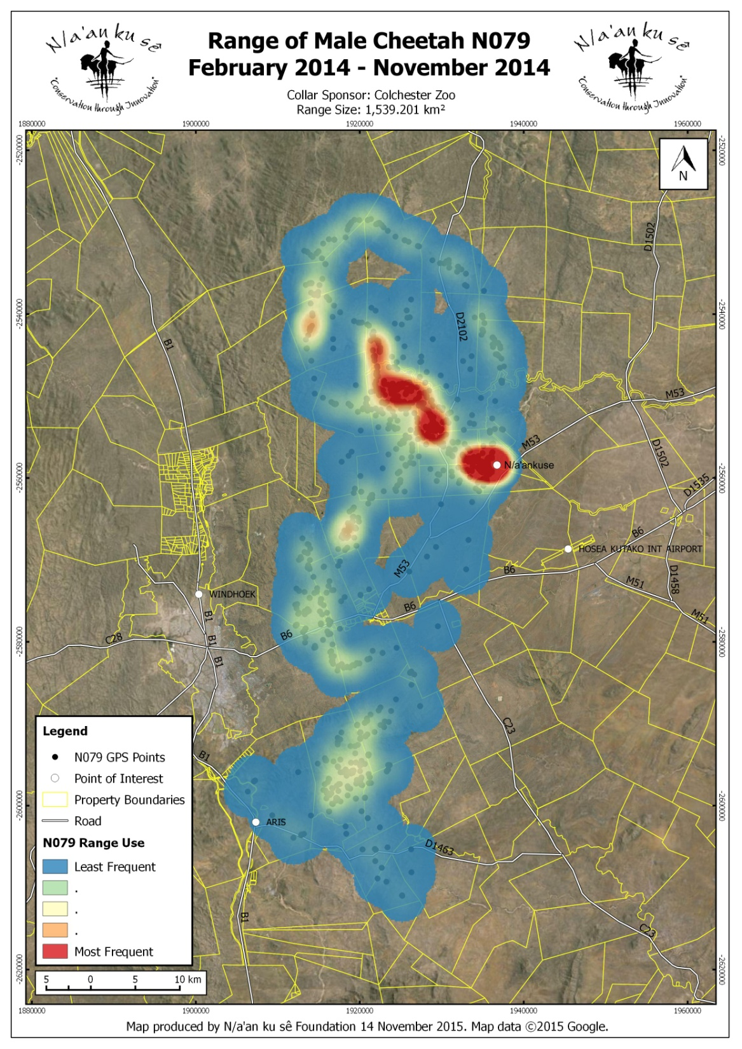

Slide 8
Human – carnivore conflict N/a’an ku sê :
Data Sharing
Sharing carnivore movements daily providing GPS locations of the previous day via email
Identify kill site
Farmer check kill site and killed species
Sharing knowledge on certain patterns
Constant communication between farmer and N/a’anku sê

Slide 9
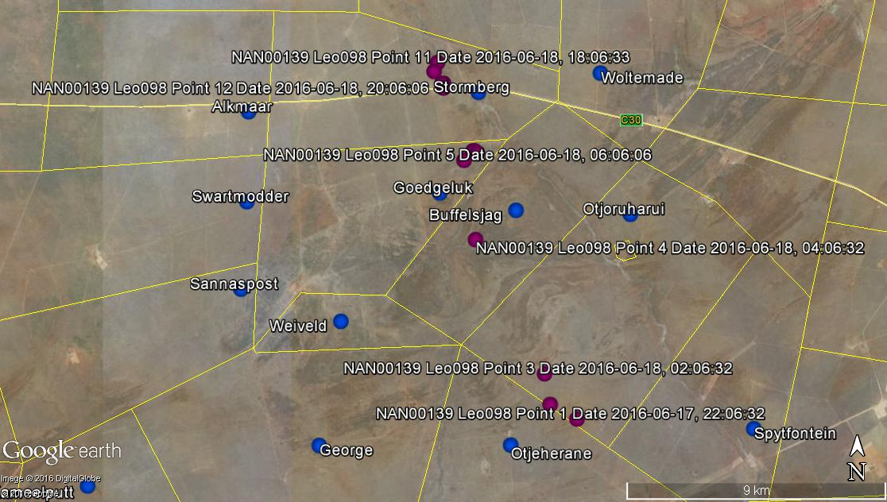
Human – carnivore conflict N/a’an ku sê:
Data Sharing

Slide 10
Human – carnivore conflict N/a’an ku sê :
Human focus
N/a’an ku sê conflict mitigation focuses on the human component of conflict
Human component essential to find long term solution to conflict
Getting farmers involved is key to success
Farmers will share information and opinions with other farmers
Slowly creating safe areas for carnivores, where farmers are predator – tolerant
Increasing farmers knowledge and interest in carnivores
Opening a door for discussion on conflict: farmer feel listened and understood => likely to get open to discussion and find other solution than lethal removal

Slide 11
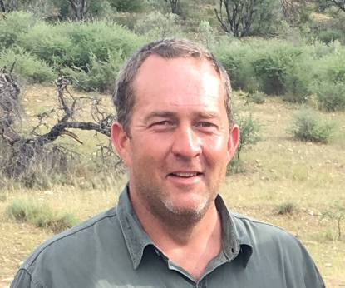
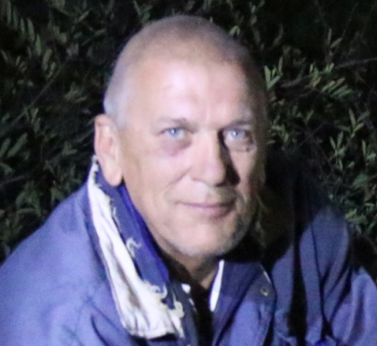
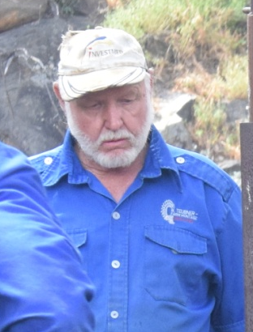
Human – carnivore conflict N/a’an ku sê:
Human focus
    Many farmers involved !
“N/a'an ku sê responded very quick to my call and was very professional and helpful. I found the data very interesting and could study the leopard's behavior. With a bit of change to my livestock management I could happily farm with the leopard in the area.”
“N/a'an ku sê's rapid response team is fantastic and did a great job with Goliath. The information that me and the other farmers get from the collar is great. We now know where Goliath is everyday.
The farmers that once hated Goliath now love him and find the updates on Goliath's location very helpful.”
“N/a'anku sê were great, very professional. The collar gave me great information and we could see that it was not that leopard causing the losses. It was interesting to see the leopard's movements and now that the collar died, we miss the updates.”

Slide 12
Human – carnivore conflict N/a’an ku sê
Results 2015-2016
    71 conflict calls, widespread in Namibia:
  31 requested advice
  40 had captured an animal
    13 got collared and released
    1 translocation
    6 release on site
    1 got shot
    For the 13 collared and released:
    10 PROVEN NON LIVESTOCK RAIDER
    2 proven taking one calf – Oppertunistic livestock raider
    1 still pending

Slide 13
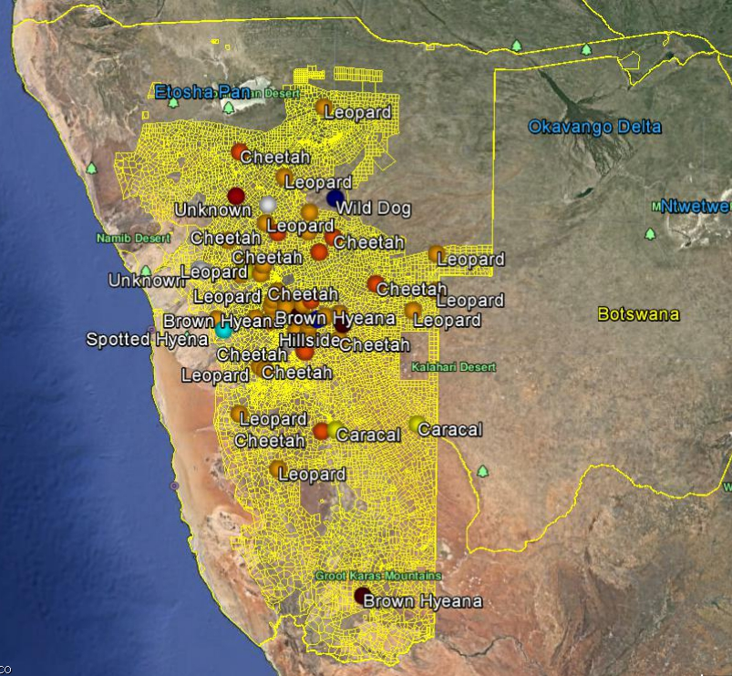
Conflict call 2015 - 2016

Slide 14
Human – carnivore conflict N/a’an ku sê:
Results 2008 – 2016
Human component:
  Worked with 650 farmers
  80% decrease in lethal removal
  Increase in tolerance towards carnivores
  90% of assisted farmers repeated request for assistance
  Increase in conflict calls => increase in trust by farmers
  Increase in farmer outreach (13 farmers for N093)
  Changing farmers’ mind set
Predator component:
  77 carnivores collared with GPS or VHF collars
    5 brown hyena
    44 cheetahs
    27 leopards
    1 serval

Slide 15
Human – carnivore conflict N/a’an ku sê
Using GPS to track translocated animals
GPS collars needed and used to track translocated animals
Translocation success evaluation, based on GPS information:
  Homing instinct : going back to conflict area
  Eventual livestock predation and further conflict assessment
  Production of offspring : assessed with GPS data

Slide 16
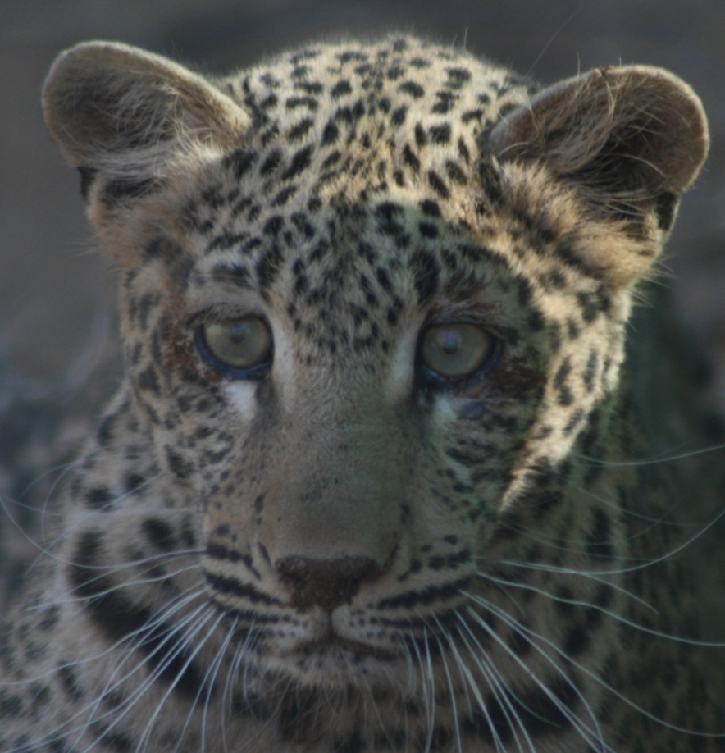
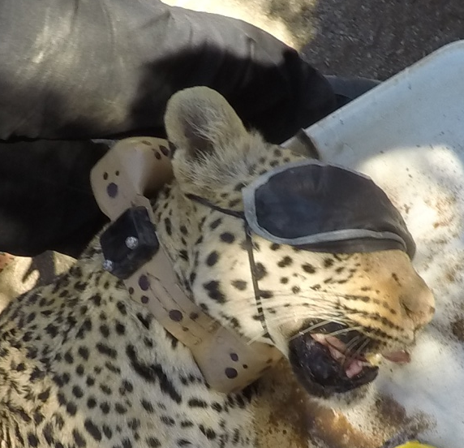
Successful translocation
Lightning case study
Young cub (4-6 months) caught on farmland in March 2008
Cared for at N/a’an ku sê Sanctuary until full-grown
Minimum contact allowed to prevent habituation
  never imprinted
Released in December 2009 into the Kulala Wilderness Reserve, in the South West of Namibia
Fitted with a GPS collar
  adapted well to her new home
  Successful hunting
  No livestock predation since 2009
Long term monitoring: 2009 – 2016 (4 collaring)
4 Litters of cubs (2011, 2013, 2015 , 2016)

Slide 17
Succes of Translocation: cheetahs (1)
“Cheetahs (Acinonyx jubatus) running the gauntlet: an evaluation of translocations into free-range environments in Namibia”, Weise,van Vuuren et al. (2015), PeerJ, DOI 10.7717/peerj.1346
  Success:
  Overall success rate of 57% after one year, 40% after 2 years
  Several females successfully raised cubs released with them
  Surviving females produced new litters
  Factors influencing Success:
  Translocation success was significantly associated with degree of habituation to humans, strongly associated with the amount of time spent in captivity
  Re-wildling of captive-reared cheetahs unsuccessful strategy
Animals intended for free-range release should not be raised in captivity and be held <250 days
  No beneficial effect of soft release to reduce exploratory movements (even after acclimation of up to 9.5 months)
  Spotted hyaena presence had a marked effect on survivorship (33% of confirmed deaths)
  Human-related mortalities has the highest impact on cheetah survival after animals left target recipient area

Slide 18
Succes of Translocation: cheetahs (2)
“Cheetahs (Acinonyx jubatus) running the gauntlet: an evaluation of translocations into free-range environments in Namibia”, Weise van Vuuren et al. (2015), PeerJ, DOI 10.7717/peerj.1346
Conflict:
  Translocated cheetahs caused little conflict (17.4%, n=23)
  Long-distance (>137 km) translocations proven effective in preventing homing
Considerations
  Translocating cheetahs into managed reserves that provide control over movements and large carnivore assemblies can mitigate the influence of humans and competing predators, thus improving prospects of survival considerably
  Cheetahs translocated into managed reserves may be beneficial for tourism interest
  Translocation can successfully conserve individual cheetahs and locally boost their populations
  Rigorous candidate and recipient area selection can improve its efficacy

Slide 19
Success of translocation: other species
“Financial costs of large carnivore translocations--accounting for conservation”, Weise van Vuuren et al. (2014), PLoS One, 15;9(8):e105042 doi: 10.1371
“A home away from home: insights from successful leopard (Panthera pardus) translocations” Weise van Vuuren et al. (2015), Biodivers Conserv, 24:1755–1774, DOI 10.1007/s10531-015-0895-7
Success translocation rate:
Leopards: 66.7% (n=6): Very high success
  117,613 km² Namibian land open for leopard translocation, allowing for 87 leopard translocations initially
  Habituation of leopard to humans highly unlikely
Cheetahs: 57% (n=23): more easily habituated than leopards
Wild dogs: Habituation to humans highly unlikely

Slide 20
Human - Puff Adder conflict project
Monitoring of translocated animals
Why study puff adders?
  Conflict about 60% of all serious snake bites in southern Africa (Branch 1996)
    most common and geographically widespread of the venomous snake species found in southern Africa
    Cryptic colouration and propensity to freeze rather than move
    => people step on them
  Reduce human-snake conflict
    Prevent snake bites
    Reduce lethal removal of puff adders
Puff adders fitted with trackers - January 2014 and December 2015
  28 individuals
Notes:
Puff adders – why?
Of the approximately 170 species and subspecies of snakes found in southern Africa (of which less than 10 per cent are dangerously venomous), the puff adder is the most common and geographically widespread of the venomous species and occurs in every habitat except for mountain-tops, true deserts and dense forests (Marais 2004).
Although the puff adder is traditionally regarded as a single monotypic species, with the exception of the subspecies somalica in the Horn of Africa, recent research (Barlow et al. 2013) has shown that it displays high level of genetic heterogeneity across its range, including within southern Africa, likely as a result of Pleistocene climatic fluctuations. Many of the genetic units identified within southern Africa appear to be close to reaching the status of full, separate species. This could potentially correlate with differences in venom composition, and thus potentially with differences in the effectiveness of the available antivenom (Currier et al. 2010). However, not a single Namibian specimen was included in this study. Understanding the affinities of Namibian populations could potentially be useful in guiding the formulation and use of antivenom for the country.
In addition, the unexpected cryptic diversity of the puff adder opens the possibility that this supposedly single widespread species may turn out to consist of multiple localised species. In that case, the conservation status of each of these more localised species will need to be assessed to ensure that the full diversity of the complex is preserved.
A thick, heavy-bodied snake which can reach 1.4m in length and weigh in excess of 5kg, the puff adder has an incredibly fast strike for a snake of its size and weight (Young 2010). Its cryptic colouration and sit-and-wait ambush style make it very difficult to observe. This, combined with its propensity to freeze, rather than move to evade detection, results in many bites when people, while walking through thick grass or bush, inadvertently step onto the unseen snake. With potent cytotoxic venom, many bites result in tissue damage, limb loss and without proper medical attention may result in death (Branch 1996, Marais 2004). The puff adder is generally accepted to be responsible for the majority of recorded snake-bite incidents. It is thought to inflict approximately 60% of all serious snake bites in southern Africa (Branch 1996).
However, accurate statistics on snake-bite are very hard to produce, as many areas where snake bites most commonly occur are remote and rural and bite victims often under-privileged. Thus, victims of snakebite are more likely to consult a trusted traditional healer than modern health care facilities, for reasons of cost, lack of transport and traditional belief. At registered medical facilities their injury would be recorded and reported to national authorities (Swaroop & Grab 1954, World Health Organisation 2010). Nonetheless, the puff adder is considered the most medically important snake in the region (World Health Organisation 2010, Currier et al. 2010).
The capture and translocation of snakes as a strategy for conservation initiatives and for the mitigation of human-snake conflict has been documented for tiger snakes Notechis scutatus in Australia (Butler et al. 2005) and for rattlesnakes Crotalus horridus and C. o. oreganus in the US (Reinert & Rupert 1999, Brown 2007). These studies found that there are observable differences in movement patterns amongst translocated snakes. Large unidirectional movements as snakes search for recognizable territory cues may in some cases increase mortality as a result of altered movement making individuals more vulnerable to predation.
27 puff adders attached with transmitters and released

Slide 21
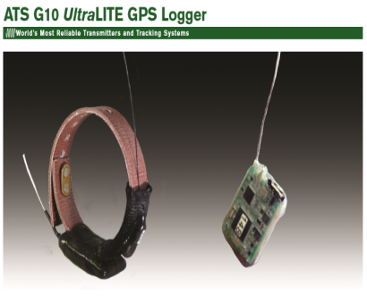
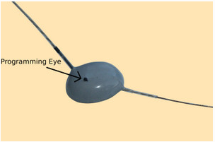
Human - Puff Adder conflict project
Monitoring of translocated animals:
Trackers
VHF transmitter
  Specifically designed for this project with NamTrack and Polytechnic of Namibia (NUST)
  D137E without programmable component
  design based on the ATS G10 UltraLITE GPS Logger
NamTrack D137E (current model specs)
  VHF transmitter - glue on style
  Weight = 13.7 g
  Diameter = 26 mm
  Height = 13 mm
  Lifetime = 1 to 7 years
  Twin antenna
Price range – approx. NAD$1 450 (transmitter)
Why opposed to other tracking methods?
  Successfully employed in other studies of reptiles
  Least invasive - no surgery required, less stress on animal, immediate tagging and release
Notes:
Several different methods for attaching transmitters to snakes can be employed. These range from external attachment to the skin, subcutaneous implantation, intra-peritoneal implantation to ingestion of prey items containing transmitters (McDiarmid et al. 2012, Újvári & Korsós 2000. Dorcas & Willson 2009).
The most commonly used method is internal implantation into the peritoneal cavity (McDiarmid et al. 2012) and has been applied in the ecological studies of many snake species worldwide (Butler et al. 2005, Brown et al. 2009, Plummer & Mills 2000, Kapfer et al. 2010, Brown 2007, Reinert & Rupert 1999).
Although internal implantation allows the use of larger, longer lasting transmitter units, there are several considerations which must be taken into account. Snakes must be removed from the study area in order for transmitters to be implanted. It also requires the individual to be anaesthetised and undergo invasive surgical procedures, which should be carried out by a qualified veterinarian under sterile conditions. Some research (Sperry et al. 2009) has described no significant effects of surgery and internal placement of transmitters. However, other more recent studies (e.g. Lentini et al. 2011) noted the development of extensive inflammatory response and associated bacterial infections in test subjects. Moreover, there are inherent delays in release time due to post-operative recovery as well as the potential effects on survivorship of study animals from post-surgery infection and possible changes in behaviour.
In this study, an external method of attachment will be used which has been employed successfully in several other studies already (Madrid-Sotelo & García-Aguayo 2008, Tozetti & Martins 2007, Wylie et al. 2011). It removes the necessity for any invasive surgical procedures as well as any associated risks, and it will reduce any detrimental effects on the survival rate of study animals. This is particularly important since survivorship assessment of translocated snakes is an integral part of the proposed project. The need for additional surgery at the end of the study to remove transmitters will also be eliminated.
In addition, external attachment can be carried out immediately at the capture location facilitating immediate release. This will reduce any stress related to the removal of animals from their resident habitat and allows a quicker resumption of natural behaviours. Because this study will be carried out over several concurrent seasons, external attachment will also drop off when study animals shed their epidermis. Therefore, no layover effects are expected to occur due to long-term attachment of transmitters.
Individuals will have transmitters attached on the dorsal surface of the body approximately two-thirds along the length of the body with the antenna trailing posteriorly. Transmitters will first be secured in place using glue. A layer of strong tape will then cover the transmitters’ leading edge to reduce the likelihood that snakes may be entangled in undergrowth as they move. The chance of entanglement is expected to be very low due to a combination of the transmitter dimensions and the inherent strength of such large-bodied snakes like the puff adder. In addition, as puff adders will shed their epidermis and the attached tracking tags regularly, the invasiveness of the proposed approach is considered minimal.
We are working in partnership with the Polytechnic of Namibia to develop and produce transmitters here in Namibia. The dimensions of these units are not expected to exceed 30mm x 15mm x 6mm (Length x Width x Height) and 25g in weight. This provides a low height profile to reduce the possibility of entanglement. Measurements are also in agreement with guidelines for recommend transmitter weights which should not exceed 4-5% of the snake’s body weight (McDiarmid et al. 2012, Újvári & Korsós 2000).

Slide 22
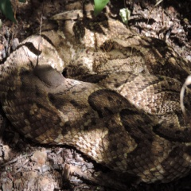
Human - Puff Adder conflict project
Monitoring of translocated animals
Goal
Research questions:
  Do puff adders have a homing / site fidelity?
  Do puff adders survive translocation (effect of translocation on PA)?
    If they do, puff adders can successfully be translocated to prevent lethal removal in conflict situations, and conserve the species
OTHER
  Territoriality / movements
  Activity patterns
  Habitat Preference
  Demography
  Population affinities and genetics
    To understand more about these animals in an attempt to reduce conflict situations
Notes:
This study is designed to investigate the habitat and space use (including movement patterns and possible territorial behaviours) of resident and translocated free-ranging puff adders. Simultaneously, the study will provide data on the effects of translocation on puff adders in comparison with resident individuals.
For resident, non-translocated puff adders we aim to examine the following variables.
Territoriality/Movements
Activity patterns
Habitat Preference
Demography
Population affinities and genetics
This study will provide the first evidence on the affinities of the central Namibian puff adders, and help determine whether these have close affinities with previously diagnosed genetic groupings (Barlow et al. 2013), or whether they constitute a novel, previously undiagnosed, potentially endemic lineage or even species. This will enhance our understanding of African biogeography and the effects Pleistocene climatic changes have had on reptile distributions in southern Africa, and could help predict the effects of predicted climate change on the distribution and viability of reptile populations in southern Africa.
We will also investigate the genetic diversity of the population with microsatellite loci currently under development in the Bangor group, and compare this with populations likely to have been subject to relatively recent range expansion in South Africa. Sampling of litters of newborn will allow testing for multiple paternity, and a comparison of reproductive traits with populations in South Africa, where parallel studies are in progress (G. Alexander, Witwatersrand University, pers. comm.), as well as an estimation of effective population size (Skrbinšek et al. 2012), thus providing a baseline for the development of further studies of spatial ecology and population processes of this species in Namibia.
In addition to the above, the following variables will be documented for snakes translocated from conflict areas:
Homing/Site Fidelity
Effects of Translocations on the Individual

Slide 23
Human - Puff Adder conflict project
Monitoring of translocated animals
Methodology
Puff adders captured when a threat at N/a’an ku sê Wildlife Sanctuary
VHF transmitters attached to dorsal surface approximately two-thirds along the length of the body with the antenna trailing posteriorly using an adhesive (Pratley Quickset Glue)
Glue covered with dirt to camouflage/conceal transmitter (ambush predators)
Tracked twice per week using standard VHF equipment (R-1000 receiver and RA-2AK H Antenna)
To avoid loosing animal and tracker: the brille (eye scale) is observed every day: if cloudy, snake brought into captivity until shedding is complete and transmitter is re-attached.
Initial translocation distance 500m: equivalent from Wernhil Park to Central Post office
After which translocation distance increased in 500m increments if recapture of snakes which returned to the vicinity of their original capture location

Slide 24
Human - Puff Adder conflict project
Monitoring of translocated animals
Results
Currently working on data analysis with NUST
Initial impressions:
  puff adder do not have a territorial homing instinct
  High % survived translocation
Where possible - learn more about puff adders to inform the development and implementation of conflict mitigation measures to reduce conflict situations and subsequent lethal persecution
Translocation is therefore an efficient and cost-effective method for dealing with human-puff adder conflict situations
2 NEIGHBOURS STUDIES

Slide 25
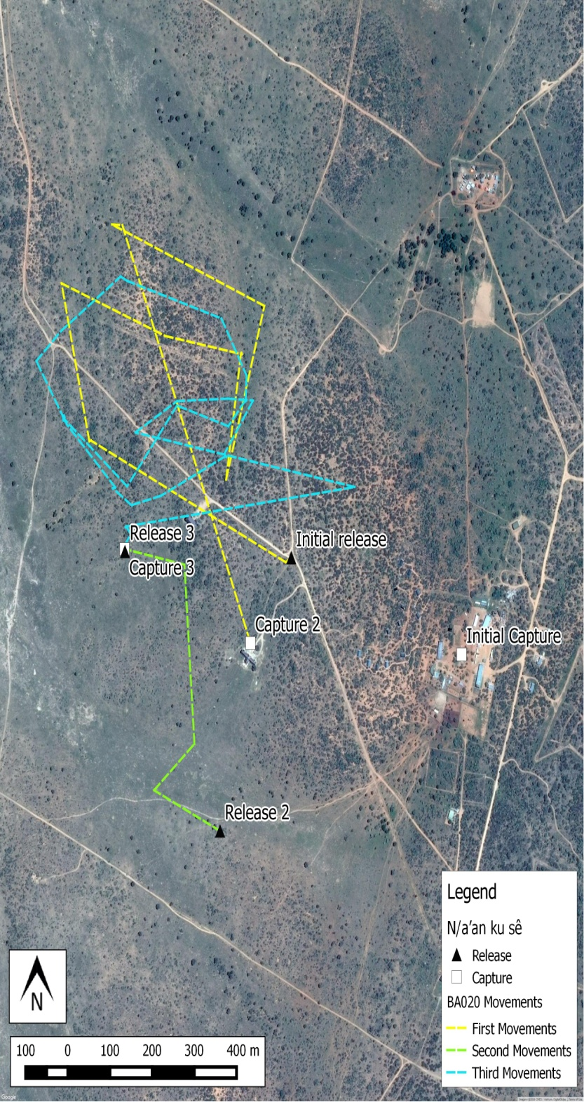
Puff Adder Project
Case Study 1
Map of BA020’s movements
Monitored between 19/6/2014 and 23/02/2015
Transmitter found on shed snake skin
BA020 survived translocation
BA020 did not return to any of the three release site however did stay in the general area

Slide 26
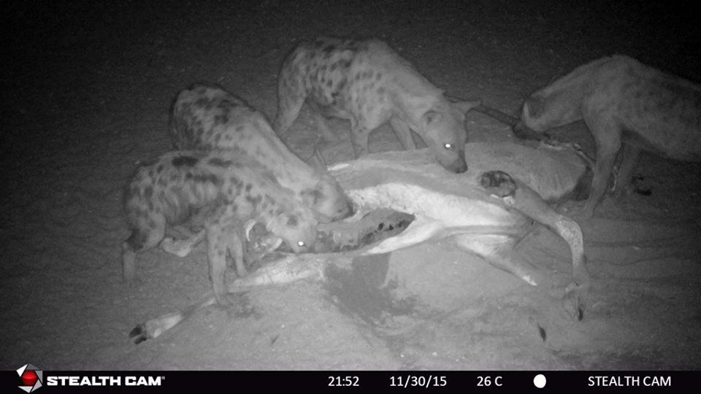
Spotted hyena project
Using GPS data for research
Initiated after a meeting with farmers, who suspected spotted hyena conflict
Research questions:
Assess suspected wild horse predation
Geographic distribution in the south western Namibia
Ecology
Species Behaviour
Methodology:
1 hyena / clan to be collared
Camera traps data analysis

Slide 27
Wild dog project in Mangetti
Using GPS data for early warning system
  Aims:
      Reduce wild dog persecution
      Establish wild dog population in Mangetti
      Establish wild dog movements in Mangetti
      Establish wild dog true livestock predation
  Methods:
      Camera traps picture analysis
      GPS collar alpha male or female of each pack
      Study movements of pack via GPS data
      Put into place a early warning system

Slide 28
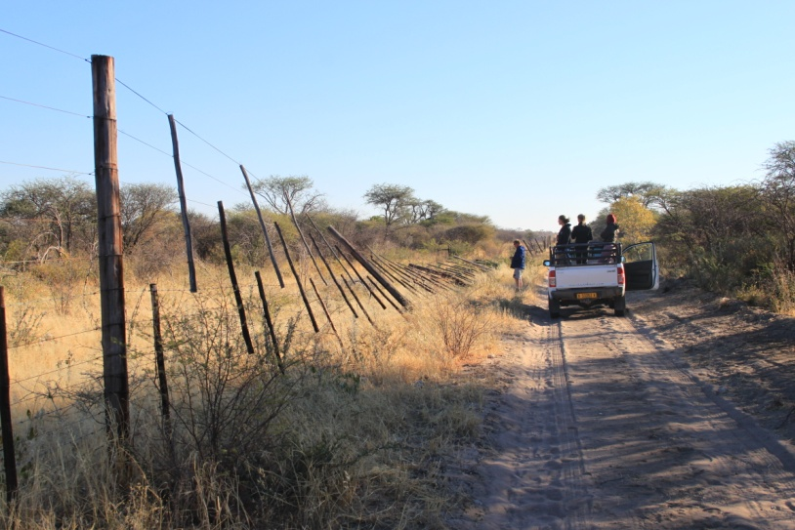
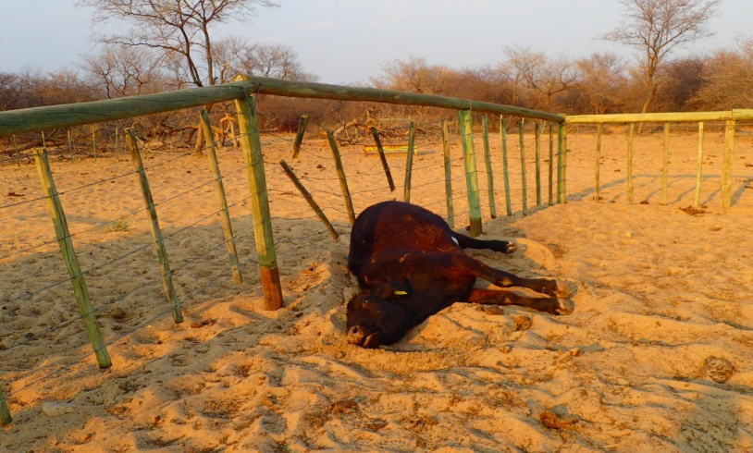
Elephant Conflict Mitigation Project
Using GPS data for early warning system
Situation
Elephants causing regular and subsequent damages to crops, fences, infrastructures, sometimes livestock loss
The African elephant is a vulnerable species on IUCN Redlist of Threatened Species
Namibian population number difficult to assess
Notes:
Puff adders – why?
Of the approximately 170 species and subspecies of snakes found in southern Africa (of which less than 10 per cent are dangerously venomous), the puff adder is the most common and geographically widespread of the venomous species and occurs in every habitat except for mountain-tops, true deserts and dense forests (Marais 2004).
Although the puff adder is traditionally regarded as a single monotypic species, with the exception of the subspecies somalica in the Horn of Africa, recent research (Barlow et al. 2013) has shown that it displays high level of genetic heterogeneity across its range, including within southern Africa, likely as a result of Pleistocene climatic fluctuations. Many of the genetic units identified within southern Africa appear to be close to reaching the status of full, separate species. This could potentially correlate with differences in venom composition, and thus potentially with differences in the effectiveness of the available antivenom (Currier et al. 2010). However, not a single Namibian specimen was included in this study. Understanding the affinities of Namibian populations could potentially be useful in guiding the formulation and use of antivenom for the country.
In addition, the unexpected cryptic diversity of the puff adder opens the possibility that this supposedly single widespread species may turn out to consist of multiple localised species. In that case, the conservation status of each of these more localised species will need to be assessed to ensure that the full diversity of the complex is preserved.
A thick, heavy-bodied snake which can reach 1.4m in length and weigh in excess of 5kg, the puff adder has an incredibly fast strike for a snake of its size and weight (Young 2010). Its cryptic colouration and sit-and-wait ambush style make it very difficult to observe. This, combined with its propensity to freeze, rather than move to evade detection, results in many bites when people, while walking through thick grass or bush, inadvertently step onto the unseen snake. With potent cytotoxic venom, many bites result in tissue damage, limb loss and without proper medical attention may result in death (Branch 1996, Marais 2004). The puff adder is generally accepted to be responsible for the majority of recorded snake-bite incidents. It is thought to inflict approximately 60% of all serious snake bites in southern Africa (Branch 1996).
However, accurate statistics on snake-bite are very hard to produce, as many areas where snake bites most commonly occur are remote and rural and bite victims often under-privileged. Thus, victims of snakebite are more likely to consult a trusted traditional healer than modern health care facilities, for reasons of cost, lack of transport and traditional belief. At registered medical facilities their injury would be recorded and reported to national authorities (Swaroop & Grab 1954, World Health Organisation 2010). Nonetheless, the puff adder is considered the most medically important snake in the region (World Health Organisation 2010, Currier et al. 2010).
The capture and translocation of snakes as a strategy for conservation initiatives and for the mitigation of human-snake conflict has been documented for tiger snakes Notechis scutatus in Australia (Butler et al. 2005) and for rattlesnakes Crotalus horridus and C. o. oreganus in the US (Reinert & Rupert 1999, Brown 2007). These studies found that there are observable differences in movement patterns amongst translocated snakes. Large unidirectional movements as snakes search for recognizable territory cues may in some cases increase mortality as a result of altered movement making individuals more vulnerable to predation.
27 puff adders attached with transmitters and released

Slide 29
Elephant Conflict Mitigation Project
Using GPS data for early warning system
Goal
Conserve a vulnerable species: Reducing persecution
Reduce damage caused by free roaming elephant populations
Estimate accurate population of Namibian elephants
Improve efficiency in conflict assessment and surveys (reduce time to go on site)
Identify herd range
use for future management plans: localisation of alternate water sources, localisation of higher conflict area
Create a Nature Reserve in Mangetti for elephants protection
Educate and engage the community (especially affected landholders)

Slide 30
Elephant Conflict Mitigation Project
Using GPS data for early warning system
Methods
  10 elephant cows fitted with GPS Collars:
    2 in the Mangetti area, north east Namibia (with MET and NDC)
    2 in the Rundu area, north east Namibia (with MET)
    6 in the Kamanjab area, north west Namibia (with MET)
Monitoring movements daily and updates provided to stakeholders of elephants conflict as an early warning system e.g.
  Mangetti – Managing the quarantine camps and veterinary fence
  Kamanjab/Rundu – Proximity to urban areas = increased likelihood of conflict situations

Slide 31
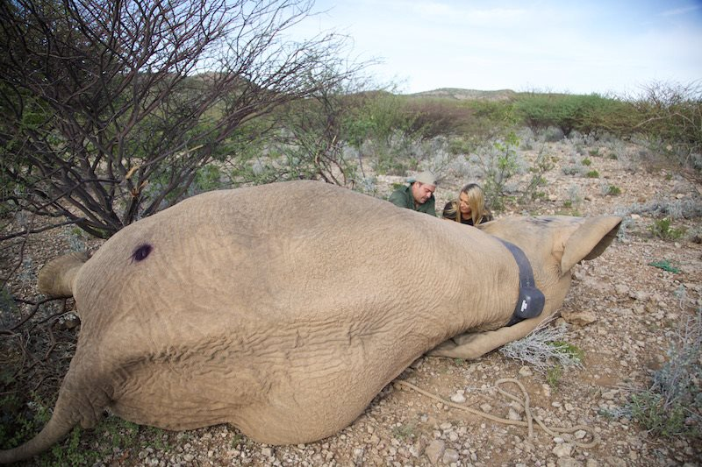
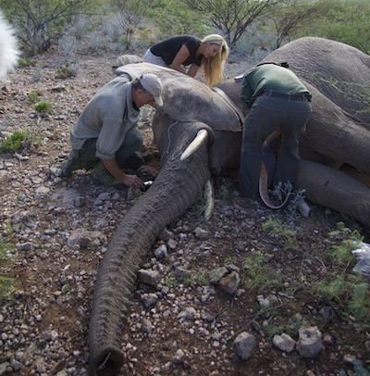
Elephant Conflict Mitigation Project
Using GPS data for early warning system
Trackers
GPS and VHF transmitter
  African Wildlife Tracking (AWT) model: drop off mechanism considered

Slide 32
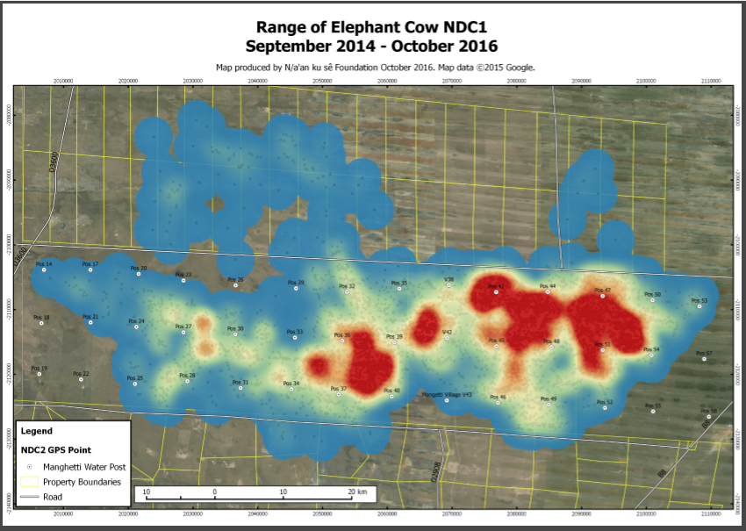
Elephant Conflict Mitigation Project
Case Study 1 – NDC 1

Slide 33
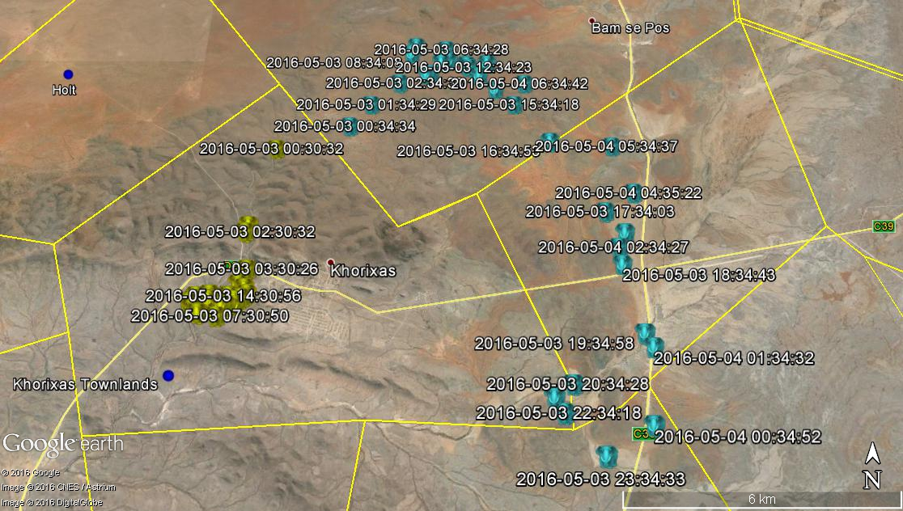
Elephant Conflict Mitigation Project
Case Study 2 – Kamanjab Elephant

Slide 34
Challenges faced with Tracking devices
Collar high cost
Battery life
Weight of collars
Collaring of young carnivores?
Retrieval of collars : drop off system / re capture of animal
No collar - induced mortality proven amongst N/a’an ku sê collared carnivores

Slide 35
Conclusion
Track where there is a need
Track to change perceptions
Track to produce academic evidence to change perception and make better decisions – evidence based conservation
ZERO collar mortalities

Slide 36
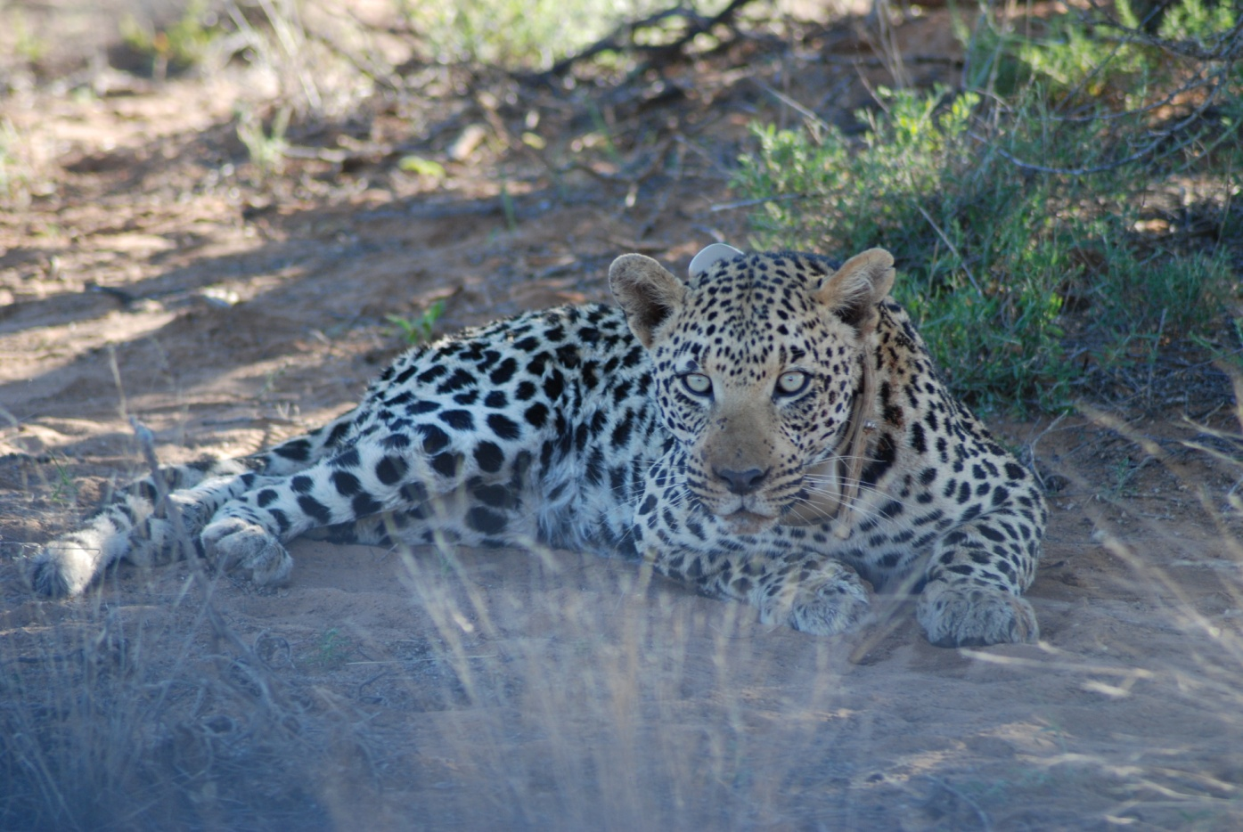
Thank you for your attention

