Slide 1
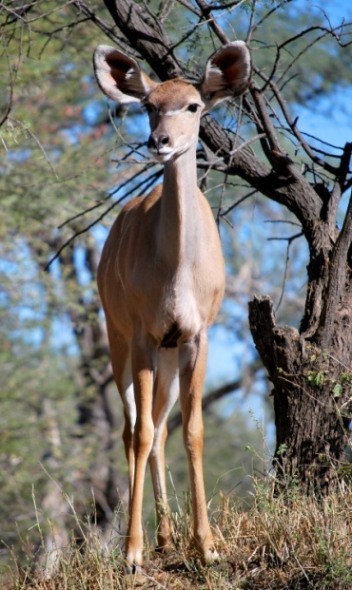
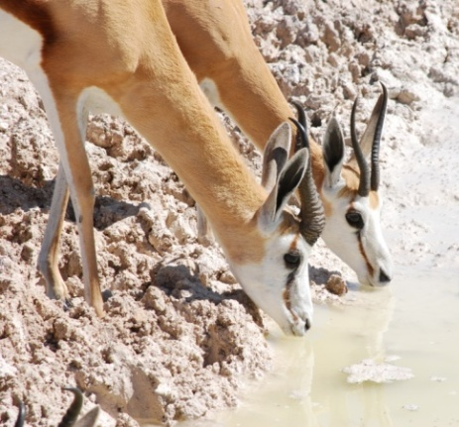
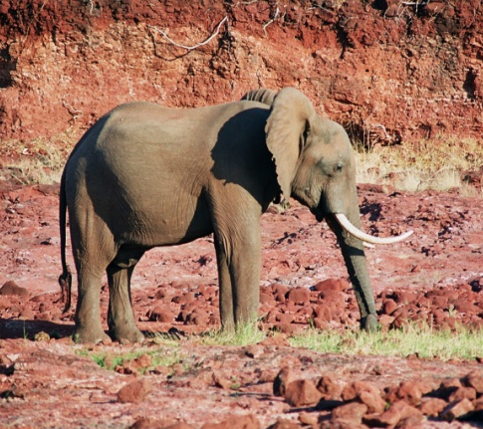
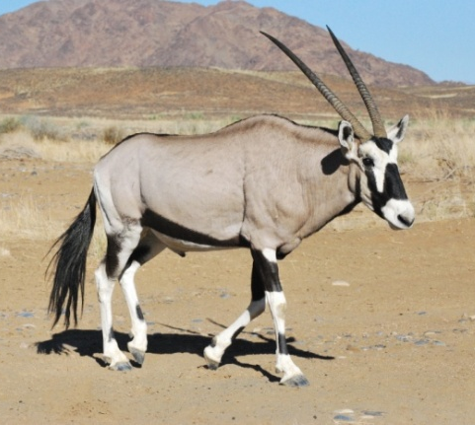
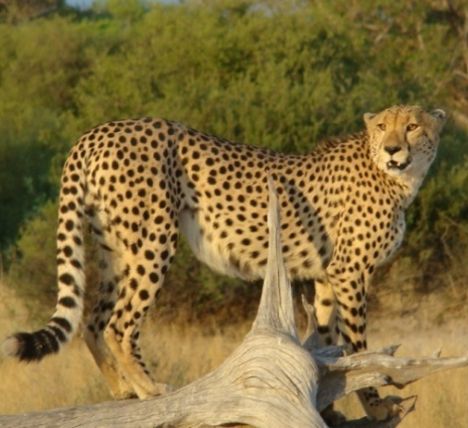
Annual Natural Resource Report
Wildlife Trends
Game counts
Data from the annual North-West game count. The Y-axis represents the number of animals seen per 100km driven.
Wildlife Populations
Species | Animals seen | Minimum estimate | Likely estimate
Cheetah | 1
Duiker | 2
Gemsbok | 2 | 0 | 10
Giraffe | 3 | 10 | 20
Jackal | 4
Kudu | 2 | 20 | 50
Ostrich | 44 | 370 | 680
Springbok | 381 | 1340 | 3260
Steenbok | 6 | 30 | 300
Photo: V. Guillemin
Predator sightings
Photo: A. Jarvis
Locally rare species
Mortalities
Species | Animals seen
Damara Dik Dik | 4
Giraffe | 81
Hartebeest | 332
Klipspringer | 3
Black rhinoceros | 4
Species | Animals dead
Locally rare species are those which are currently infrequently observed in the conservancy
No mortalities were recorded during patrols
The index (Y-axis) is calculated as the number of sightings per event book
Photo: A. Jarvis
Photo: V. Guillemin
Photo: A. Jarvis
Photo: S. Linder
Photo: S. Linder
Sorris Sorris

Slide 2
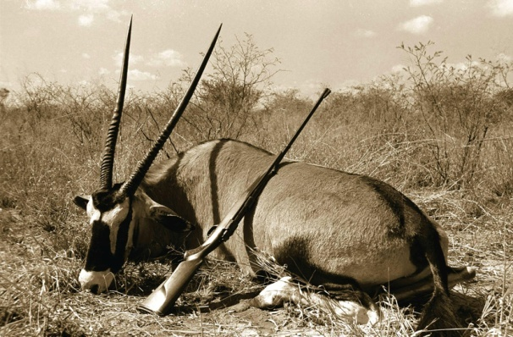
Sorris Sorris- 2009
Wildlife Use
Wildlife Income
Species | Quota | Type of Utilisation |  |  |  |  |  | Total used
 |  | Own Use | Trophy | Capture | Shoot & Sell | Traditional | Problem animal
Springbok | 300 | 77 | 7 |  |  |  |  | 84
Kudu | 6 |  |  |  |  |  |  | 0
Hyena | 1 |  |  |  |  |  |  | 0
Jackal | 15 |  |  |  |  |  |  | 0
Ostrich | 10 |  | 3 |  |  |  |  | 3
Klipspringer | 1 |  |  |  |  |  |  | 0
Baboon | 10 |  | 2 |  |  |  |  | 2
Steenbok | 4 |  | 1 |  |  |  |  | 1
Zebra |  |  | 3 |  |  |  |  | 3
Gemsbok | 4 |  | 1 |  |  |  |  | 1
Leopard | 2 |  |  |  |  |  |  | 0
Cheetah | 1 |  |  |  |  |  |  | 0
Sandgrouse | 250 |  |  |  |  |  |  | 0
Wildlife Introductions
Year | Species | Number
2006 | Hartmann’s zebra | 99
2008 | Hartebeest | 68
2009 | Hartebeest | 98
Photo: H. Denker
Natural Resource Management
Threats
Performance:
Weak Good
Human-Wildlife Conflict
Poaching
Incidents
Incidents
Species | 2003 | 2004 | 2005 | 2006 | 2007 | 2008 | 2009
Baboon |  |  | 4 | 3
Caracal |  |  | 3 | 21
Cheetah | 2 |  |  | 7 |  |  | 12
Elephant | 86 | 61 | 37 | 39 |  |  | 4
Hyaena | 3 | 3 | 11 | 18 |  |  | 18
Jackal | 16 | 43 | 33 | 34 |  |  | 38
Leopard | 5 | 1 | 3 | 8 |  |  | 2
Lion |  | 1
Species 2009
Red bars indicate weak areas in the conservancy management performance which need to be addressed. Green bars indicate positive management performance.
Effort:
Number of Community Game Guards: | 4
Environmental monitoring
Damage
Rainfall (mm)
The species chart indicates the most troublesome to least troublesome conflict species in the conservancy. The Y-axis in HWC and poaching charts represents number of incidents.
Years with no bars indicate gaps in data collection
Sorris Sorris

