Slide 1
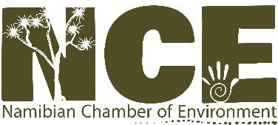
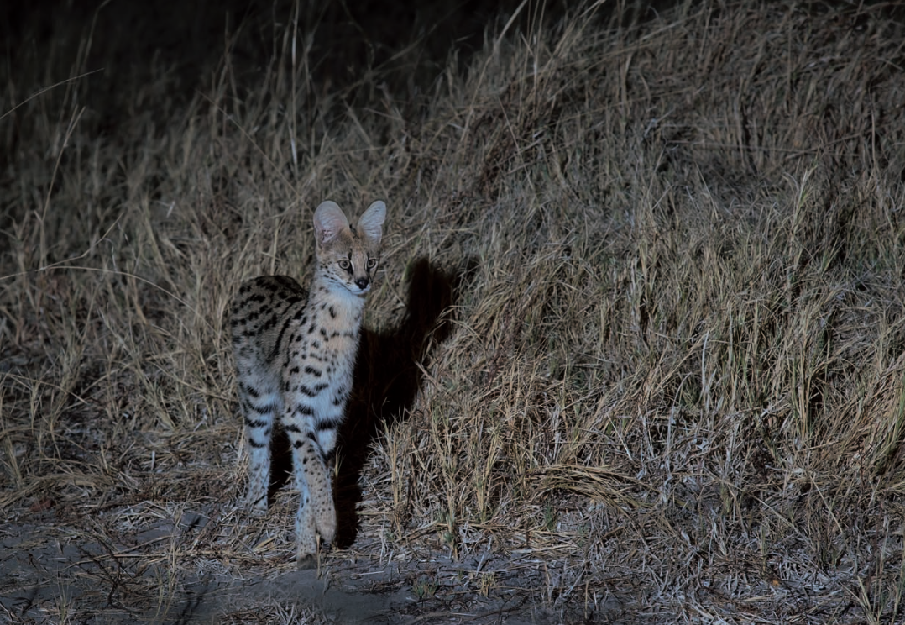
Serval (Leptailurus serval)
© P. Meier
Species status assessment compiled by Stéphanie Périquet & Gabriela Fleury (CCF) & IZW
Symposium on Red Data status of carnivores in Namibia (8th to 10th November 2017)

Slide 2
Global assessment
IUCN Namibia Threats Actions Sources
Last assessment: 2015
LC since 1996
Population trend: STABLE

Slide 3
Southern Africa
IUCN Namibia Threats Actions Sources

Slide 4
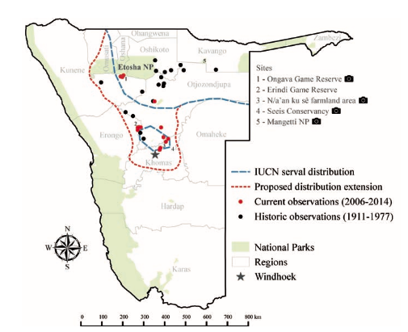
Namibia
IUCN Namibia Threats Actions Sources
Data from CCF
(Stratford at al., 2016)

Slide 5
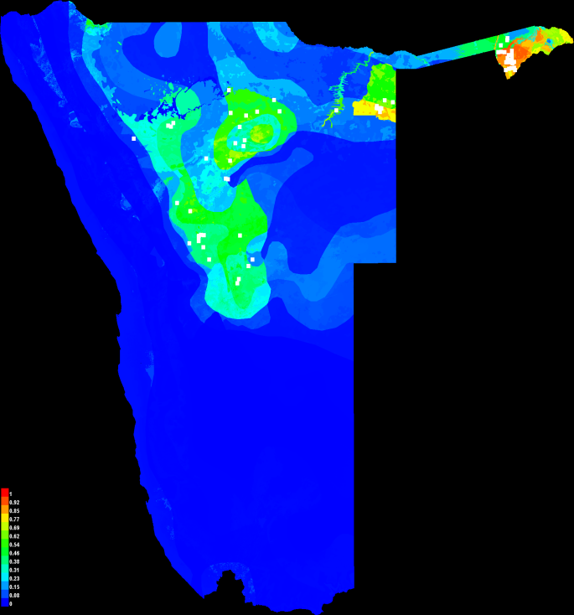
Namibia Edwards et al. (in prep)
IUCN Namibia Threats Actions Sources
Modelled serval distribution for Namibia based on Edwards et al (in prep) using camera trap data from the MET, the IZW and the Kwando Carnivore Project and confirmed serval sightings.
The map has been obtained with the software MAXENT. This gives an idea of what could be done for each one for the carnivores datasets in Namibia.

Slide 6
Threats
IUCN Namibia Threats Actions Sources
Indiscriminate farmer removal of predators as they occasionally prey upon poultry and young sheep and goats, but the problem is not considered severe.
Major threat: wetland habitat loss and degradation.

Slide 7
Actions
IUCN Namibia Threats Actions Sources
Highlighting the important role they can play in keeping rodent numbers down is critical for building farmer tolerance.
Wetland conservation is thought to be key to their conservation. For these reasons, it is vital to assess the species habitat requirements and to create an updated action plan for the species in Namibia.

Slide 8
Sources
IUCN Namibia Threats Actions Sources
IUCN Red List
CCF (camera trapping)
Carnivore Tracker app (sightings)
Ingrid Wiesle (camera trapping + sightings)
IZW
Anderson, M. D. (2013). Proteles cristatus. In The Mammals of Africa. Volume V: Carnivores, Pangolins, Equids, Rhinoceroses, (ed. J. Kingdon and M. Hoffmann). Bloomsbury Publishing, London.
Avgan, B., Henschel, P. & Ghoddousi, A. (2016). Caracal caracal. The IUCN Red List of Threatened Species e.T3847A102424310, accessed on 12 Aug 2017, http://www.iucnredlist.org/details/3847/0
BALME, G.A., SLOTOW, R. and HUNTER, L.T.B. (2009). Impact of conservation interventions on the dynamics and persistence of a persecuted leopard (Panthera pardus) population. Biological Conservation 142(11): 2681-2690.
Holekamp, K. E. & Kolowski, J. M. (2009). Family Hyaenidae (Hyenas). In Handbook of the Mammals of the World. Vol.1: Carnivores, pp. 234-260. Lynx Edicions.
Durant, S. M., Mitchell, N., Groom, R. J., Pettorelli, N., Ipavec, A., Jacobson, A. P., Woodroffe, R., Böhm, M., Hunter, L. T. B., Becker, M. S., Broekhuis, F., Bashir, S., Andresen, L., Aschenborn, O., Beddiaf, M., Belbachir, F., Belbachir-Bazi, A., Berbash, A., Brandao de Matos Machado, I., Breitenmoser, C., Chege, M., Cilliers, D., Davies-Mostert, H. T., Dickman, A. J., Ezekiel, F., Farhadinia, M. S., Funston, P. J., Henschel, P., Horgan, J., de Iongh, H. H., Jowkar, H., Klein, R., Lindsey, P. A., Marker, L. L., Marnewick, K., Melzheimer, J., Merkle, J., M&apos;Soka, J., Msuha, M., O&apos;Neill, H., Parker, M., Purchase, G., Sahailou, S., Saidu, Y., Samna, A., Schmidt-Küntzel,., Selebatso, E., Sogbohossou, E. A., Soultan, A., Stone, E., van der Meer, E., van Vuuren, R., Wykstra, M. & Young-Overton, K. (2017). The global decline of cheetah Acinonyx jubatus and what it means for conservation. Proc. Natl. Acad. Sci. U.S.A., 2016, 528-533.
Durant, S. M., Mitchell, N., Ipavec, A. & Groom, R. J. (2015). Acinonyx jubatus. The IUCN Red List of Threatened Species 2015: e.T219A50649567, accessed on 12 Aug 2017, http://www.iucnredlist.org/details/219/0
Fabiano, E., 2013. Demografia histórica e contemporânea de guepardos (Acinonyx jubatus) na Namíbia, África Austral. PhD thesis, Pontifícia Universidade Católica do Rio Grande do Sul, Rio Grande do Sul, Brazil.
Hoffmann, M. (2014). Otocyon megalotis. The IUCN Red List of Threatened Species 2014: e.T15642A46123809, accessed on 12 Aug 2017, http://www.iucnredlist.org/details/15642/0
Hoffmann, M. (2014). Canis adustus. The IUCN Red List of Threatened Species 2014: e.T3753A46254734, accessed on 12 Aug 2017, http://www.iucnredlist.org/details/3753/0
Hoffmann, M. (2014). Vulpes chama. The IUCN Red List of Threatened Species 2014: e.T23060A46126992, accessed on 12 Aug 2017, http://www.iucnredlist.org/details/3753/0
Kurberg, L. (2005). The effect of grazing on Bat-eared foxes, and how farmers in Namibia perceive the Bat-eared fox, Uppsala University.
Marker, L. L. & Dickman, A. J. (2005). Notes on the spatial ecology of caracals (Felis caracal), with particular reference to Namibian farmlands. Afr. J. Ecol. 43, 73-76.
Mitchell, J. D. (2002). Termites as pests of crops, forestry, rangeland and structures in Southern Africa and their control. California State University, USA.
STEIN, A.B. (2011). Namibian National Leopard Survey. Unpublished Report. Stein AB, Fuller TK, DeStefano S, Marker LM (2011) Leopard population and home range estimates in north-central Namibia. African Journal of Ecology 49: 383-387
Skinner, J. D. & Chimimba, C. T. (2005). The Mammals of the Southern African Subregion, 3 edition. Cambridge University Press.
Sillero-Zuberi, C. (2009). Family Canidae (Dogs), (ed. D. E. Wilson and R. A. Mittermeir). Lynx Edicions, Barcelona.
Sunquist, M. & Sunquist, F. (2009). Family Felidae (Cats). In Handbook of the Mammals of the World Vol.1 Carnivores, (ed. D. E. Wilson and R. A. Mittermeir), pp. 54-168. Lynx Edicions, Barcelona.
Stratford, K., Weise, F. J., Melzheimer, J., & Woronin-Britz, N. (2016). Observations of servals in the highlands of central Namibia. Cat News, 64, 1–9.

