Slide 1
An overview
Dr monique Mackenzie & Prof norman owen-smith
Centre for research into ecological and environmental modelling (CREEM)
Senior lecturer in mathematics and statistics
University of st Andrews, UK

Slide 2
The next few minutes
Objectives of the meeting
Ideal outcomes (hopes and dreams)
Some ideas about how to achieve these outcomes
Possible next actions

Slide 3
Main objective: Using tracking data to inform conservation and management:
What tag data is being collected? Spatial/temporal coverage
How can we use this tagging data to assist conservation and/or wildlife management?
Ideal outcomes:
Better collaboration
Understanding the current situation
Quantifying changes looking forward (either climate based or as a result of conservation-based activities)
Identify possible funding avenues

Slide 4
Better collaboration
Creatures cross boundaries
The effects of climate change require us to look far and wide
It can be more efficient – e.g. combining predator and prey abundance and distribution maps
Greater insights based on shared information & better decisions

Slide 5
Understanding the current situation
How many creatures do we have in an area of interest?
What are the key characteristics of the population?
Age-structure, ‘health’ etc
Where are the animals found? Are there any hotspots?
Why are they found, where they are found? Key drivers for distribution

Slide 6
Understanding the current situation
Where are the animals not found? Are there any exclusion areas?
What are the effects of any fences/boundaries?
What would we expect to see if there were no boundaries present?
Compare the current reality with what we’d expect to see without boundaries.
How can we use what we have to conserve a species?
E.g. an early warning system for poaching using vultures.

Slide 7
Quantifying the effects of any changes going forward
Quantifying changes in:
Distribution
Abundance
Home range
Overlap with other creatures (including humans)

Slide 10
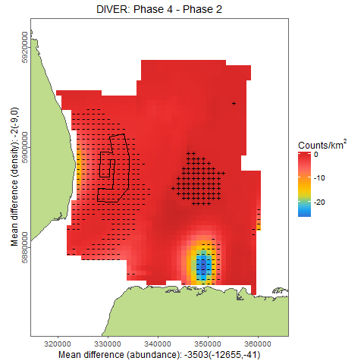

Slide 11
Quantifying the effects of any changes going forward
Assessing the power to detect change:
Site wide changes (e.g. overall decline)
Localised changes/redistribution (e.g. lower numbers at a disturbance site
Use what we have as ‘reality’
Impose change scenarios
What’s the chance we detect change when it’s there?

Slide 12
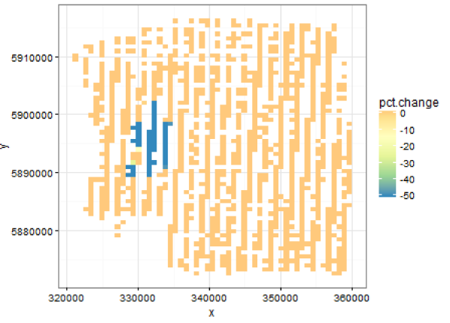

Slide 13
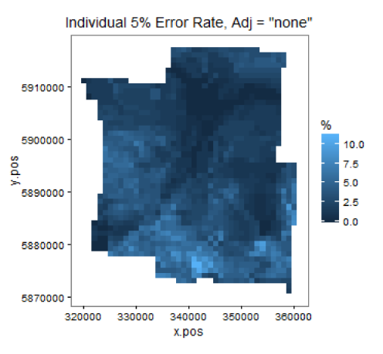

Slide 14
Some ideas about how to achieve these outcomes: Collaboration
Strategic planning via a group representing all stakeholders:
Policy makers, industry, scientists, community representatives
What do we know? Where are the gaps?
Prioritise filling these gaps & identifying funders
Sharing data: commonly agreed format

Slide 15
Some ideas about how to achieve these outcomes: Understanding the current situation
Data on the right spatial and temporal scales
Collecting covariate information (or getting it somehow)
Using methods which are fit-for-purpose
Telemetry data is repeated measures data (many observations on relatively few individuals) and the analysis methods must account for the correlated nature of the data.

Slide 16
Some ideas about how to achieve these outcomes: Understanding the current situation
Using methods which are fit-for-purpose:
Pretending your data are sets of independent points can lead you to make dodgy conclusions.
You are likely to conclude that covariate relationships/effects are genuine when they are not.
You are likely to conclude that change has occurred when it has not.
Boundaries should be respected and explicitly included in the analysis approach to avoid `leakage’ across boundaries. This would also enable fence effects to be quantified.

Slide 17
Some ideas about how to achieve these outcomes: Quantifying change
Quantifying changes using trusted/standardised methods:
Distribution, Abundance, Home range etc
Translating results to stakeholders
Linking shifts in distributional patterns with behaviour to make meaningful conclusions:
What were they doing when they were there?
What are they doing now?
What are the population consequences of this change?

Slide 18
Some ideas about how to achieve these outcomes: Quantifying change
Given the data/model available, what is the power to detect change?
Site wide changes in abundance(e.g. overall decline)
Localised changes/redistribution. Shifts in species distribution and abundance.

Slide 19
Possible next actions
Form/co-opt a well composed group and make a plan
Think critically about any model-based results:
Does your analysis pass the ‘sniff test’?
Help the decision makers by listing the important things to check
Training and/or collaboration
Can the results form case studies for use in universities/schools?
Masters student projects, PhD projects, post-doctoral researchers

Slide 20
Possible next actions
Quantify the power to detect change based on what we know -- do we have sufficient data?
Convert the satellite tracking data into conservation activities

