Slide 1
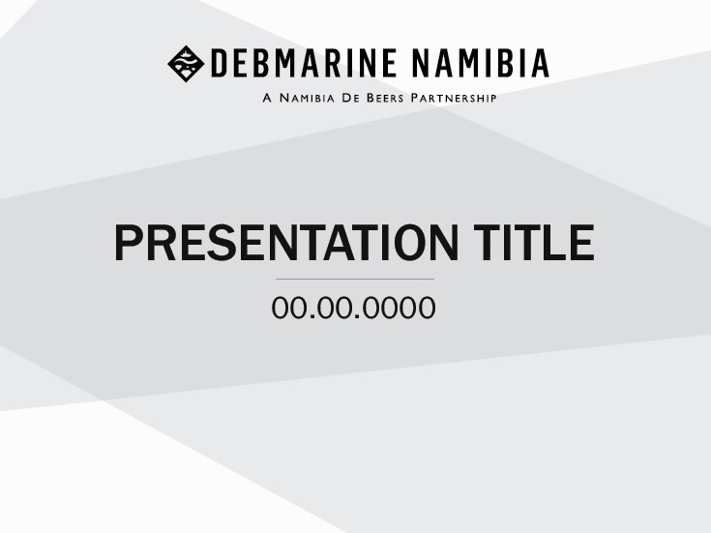
Presentation title to go here
(overwrite this text)
Overview of environmental management at DBMN
Connie Claassen - Date 28 – 30 June 2017
Presenter/Date (Overwrite this text)
Internal Confidential Highly Restricted

Slide 2
Outline
Background
  Mineral Deposit
  Fleet
  Mining Operations
Environmental Management at DBMN
  ISO14001:2004
    Research
    Assurance
Current Challenges
Success stories
Improvement Opportunities
Strategic Plan – Environmental Plan suggestions

Slide 3
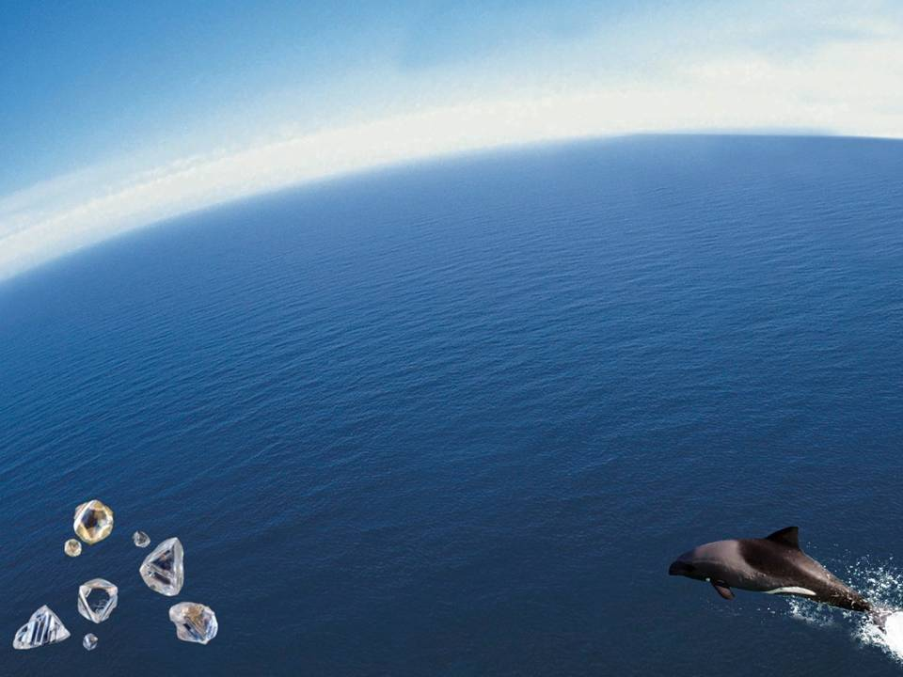
This is our Diamond Mine

Slide 4
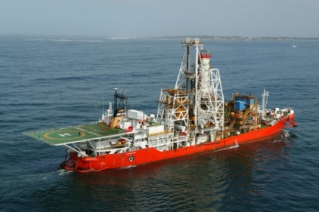
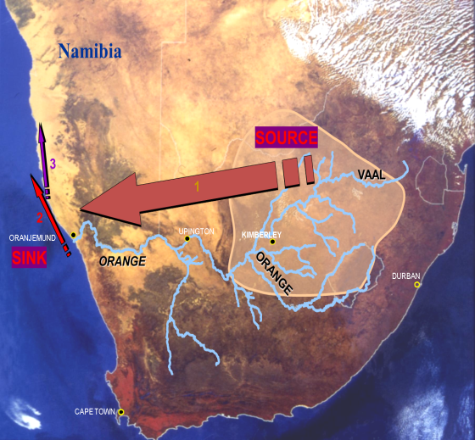
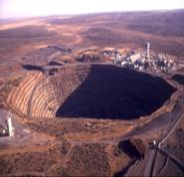

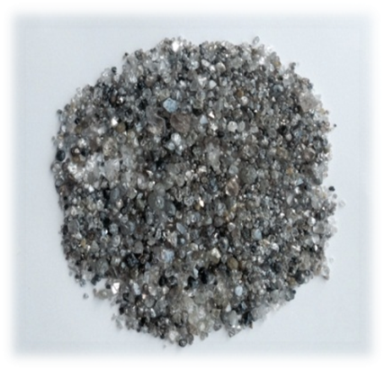
FORMATION OF THE WEST-COAST MEGA PLACER
95% GEM QUALITY
1 Fluvial Conveyor
2 Marine Conveyor
3 Desert Conveyor
LOWER % GEM QUALITY

Slide 5
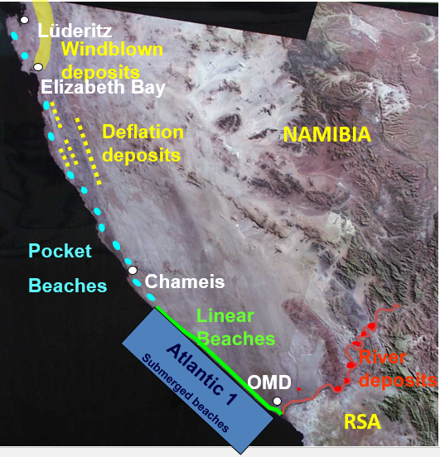
ALLUVIAL DIAMOND DEPOSITS
Distribution of diamond
deposits
Atlantic 1 mining area is approx. 6 000 km²

Slide 6





SHAREHOLDER STRUCTURE
50%
50%
100%
100%

Slide 7
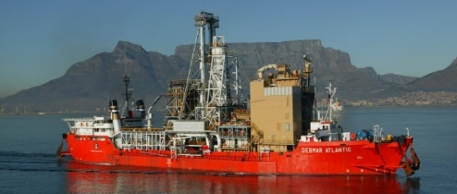
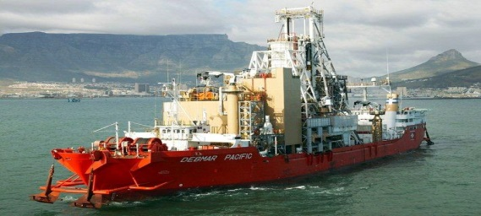
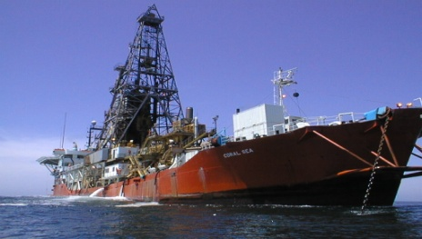
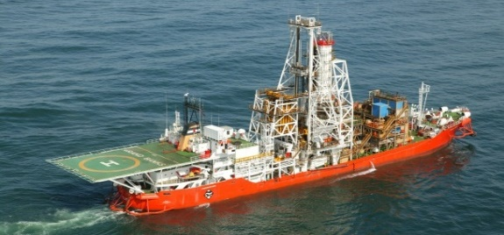
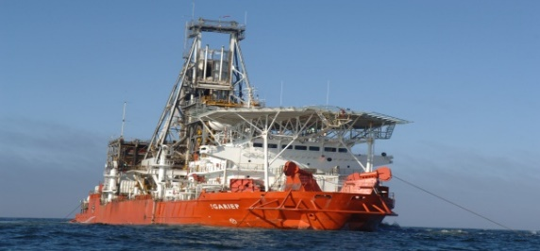
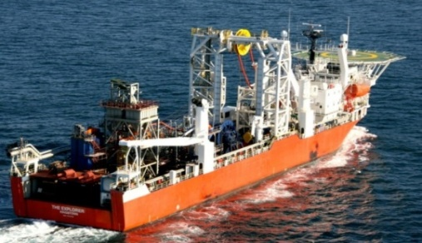
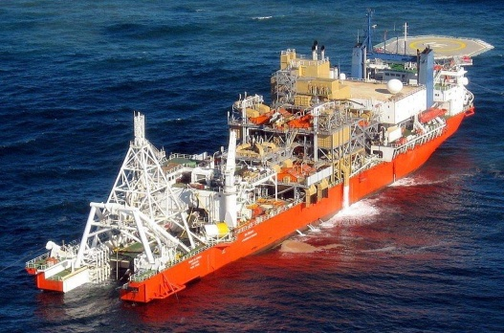
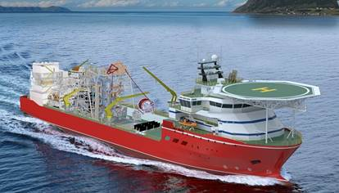
THE FLEET
Debmar Atlantic
Debmar Pacific
Coral Sea
(DBM – PPD/Mining)
Grand Banks
!Gariep
The Explorer
(NUTAM – Charter)
Mafuta
SS Nujoma

Slide 8
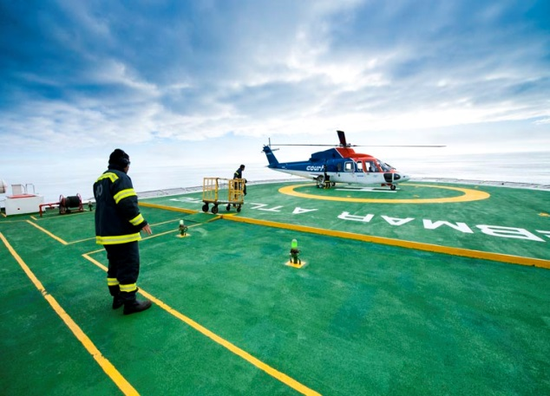
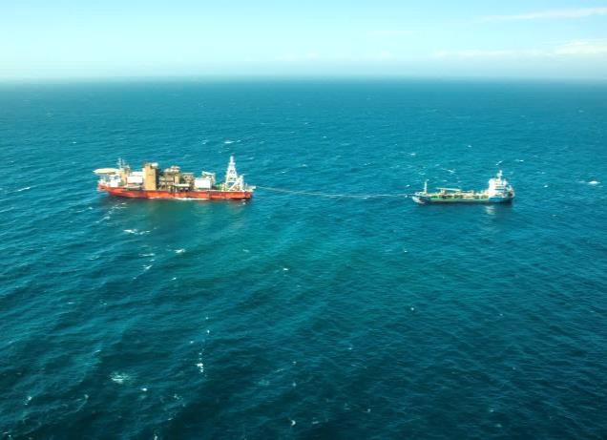
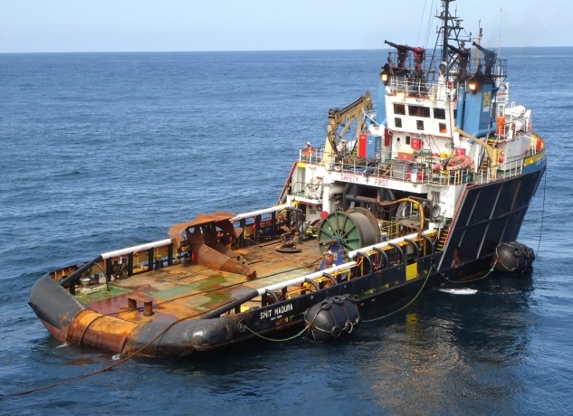
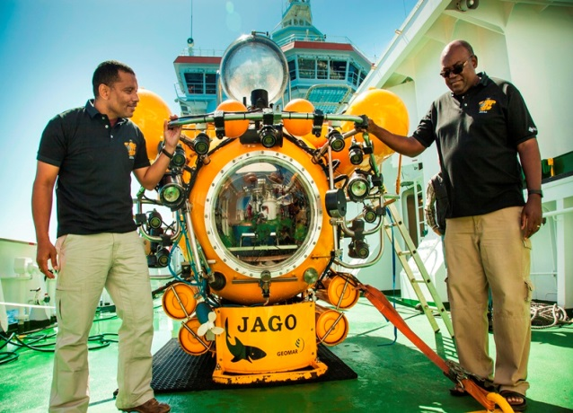
THE MINING OPERATIONS REQUIRE EXTENSIVE LOGISTICS AND MARINE OPERATIONAL SUPPORT
Vessel Operations
Vessels remain at sea on average for 2 ½ years before in-port maintenance
24 / 7 / 365
Vessels supported via launch and helicopter operations
Refuelling conducted at sea
Freshwater produced on-board (desalinisation)
Crew of ~ 60 people
Crew rotates 28 days on, 28 days off
Crew change via helicopter
Crew work 12 hour shifts
Diamonds flown off by helicopter

Slide 9
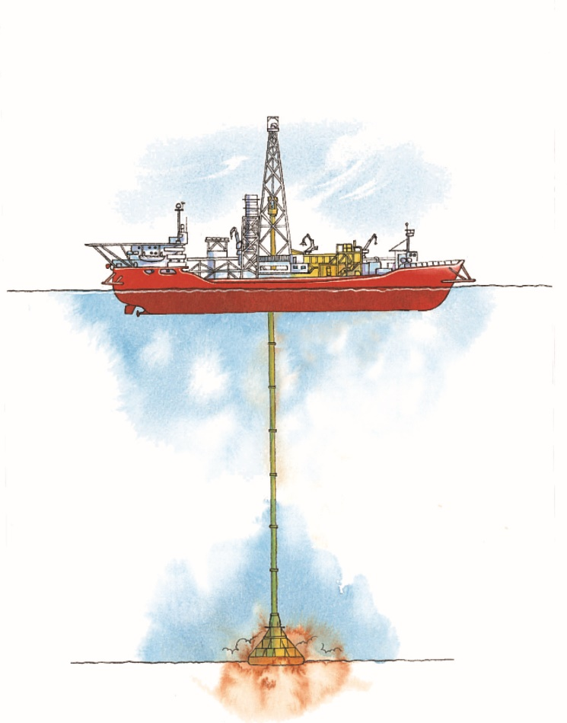
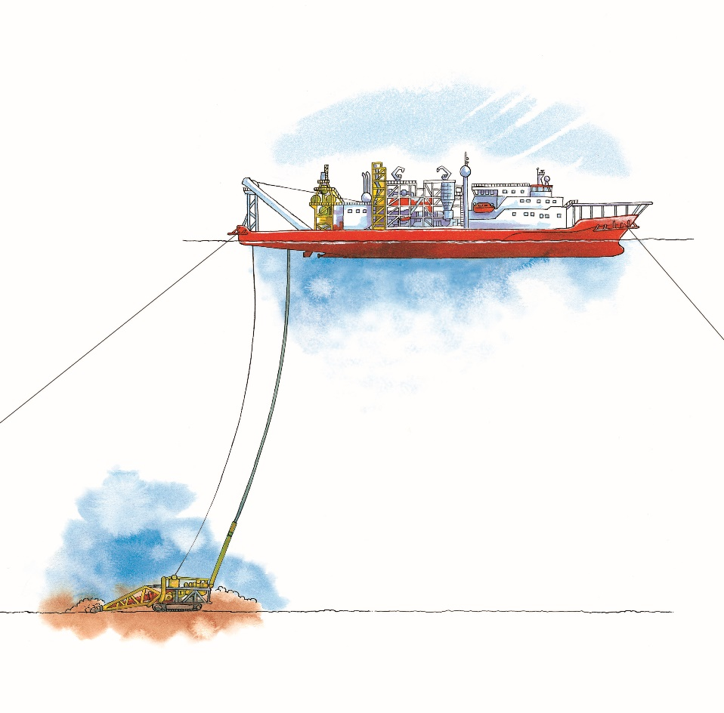
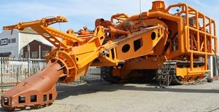
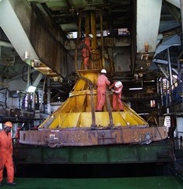

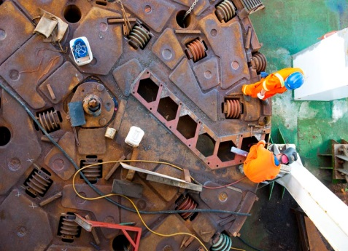
MINING METHOD, EXTRACTION & PROCESS
Horizontal Mining System
Crawler
Vertical Mining System
Drillship
100-140m
Water depth
500-700NB
steel riser
700mm flexible riser
2.5MW dredge
280 ton crawler (D10H tracks)
5.7m – 7.2m diameter rotating tool with suction channel

Slide 10
The work of the environmental department: Iso 14001:2004
define and document the scope of the EMS system
Environmental Policy
document, implement, maintain and continually improve the ems
Integrate the environmental management system
Provide training
develop relationships with key people responsible for significant environmental impacts
Monitor environmental management per department
- environmental inspections
Monitoring of waste (incineration, separation, documentation), water use, diesel use, marine gas oil use,
Legal complicance

Slide 11
The work of the environmental department: Iso 14001:2004
Environmental policy
Planning
  Environmental Aspects
  Legal and other requirements
  Objectives, targets and programmes
Implementation and operation
  Resources, roles, responsibility and authority
  Competence, training and awareness
  Communication
  Documentation
  Control of documents
  Operational control
  Emergency preparedness and response
Checking
  Monitoring and measurement
  Evaluation of compliance
  Nonconformity, corrective action and preventive action
  Control of records
  Internal Audit
  Management review

Slide 12
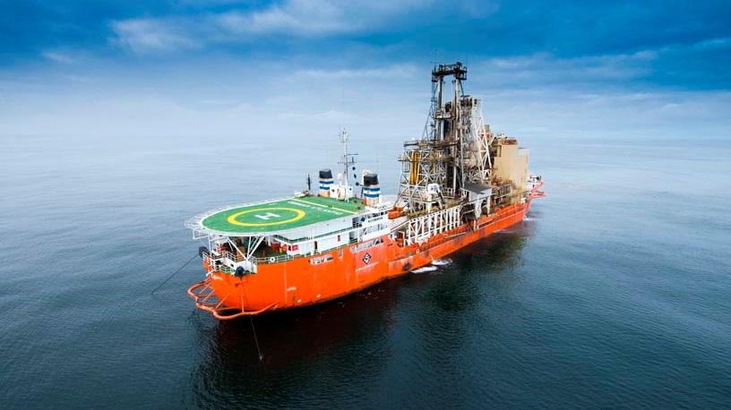
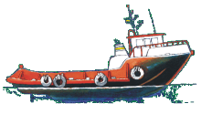
The work of the environmental department: Iso 14001:2004
Conserve the use of water, energy and other natural resources, and prevent pollution from waste, emissions and harmful substances to the environment
DISPOSAL
RECYCLING
Vessels: Scrap Metal Used Oil Printer Cartridges & Dry Cell Batteries | Whk Offices: Paper Cans Plastic Glass Printer Cartridges & used batteries
hazardous waste
general waste
TREATMENT
separation
incineration
compaction
maceration
RELEASED AT SEA
macerated food waste
treated bilge water
treated sewage
Waste removed via launch to shore

Slide 13
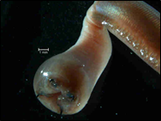
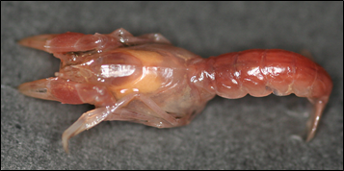
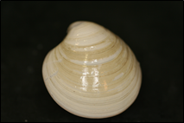

The work of the environmental department: Iso 14001:2004
Research: benthic monitoring programme
One of the significant environmental risks to DBMN is the removal of seabed and consequent disturbance of the natural habitat of benthic communities. To address this risk, the benthic monitoring program was established. Small benthic macrofauna, which is a food source for fish live in the first 30cm of sediment, and thus it is necessary to monitor the impact mining has on these animals.
Glycera convolute head Calocaris barnardi Dosinia lupines orbignyii Lumbrineris heteropoda difficilis
The benthic program has two main objectives:
To determine the impacts of mining and;
To determine the recovery rate of mined sites.
The Before-After-Control-Impact design focuses on first determining what the natural state of the environment is before mining and then once mining has taken place what are the impacts after the disturbance. Once a site has been disturbed (through mining) it is monitored to determined the natural recovery rate. This is done with control and impact site pairs.
Currently the benthic program has 3 different sites; control sites, impact sites and natural variability sites.

Slide 14
Total number of sites: 69
Northern
Southern
Central
RBR Concerto CTD

Slide 15
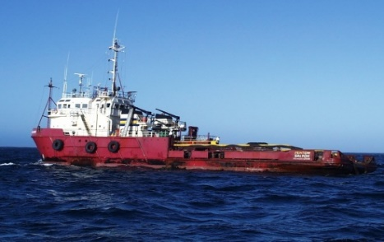
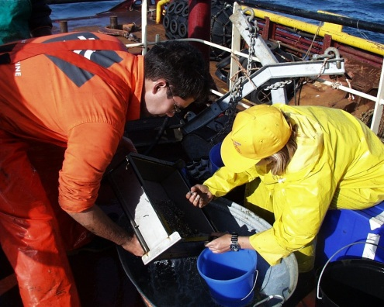
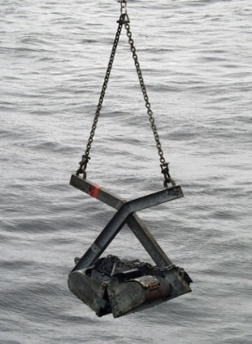
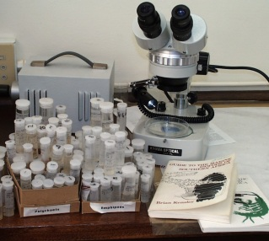

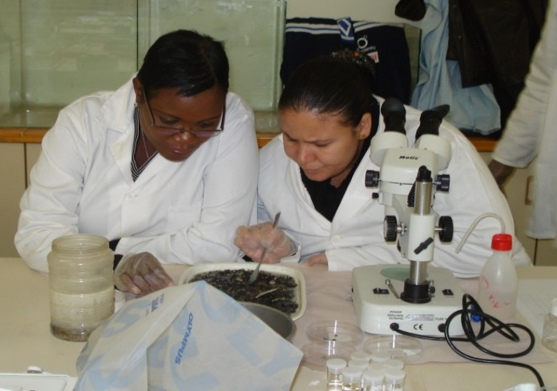
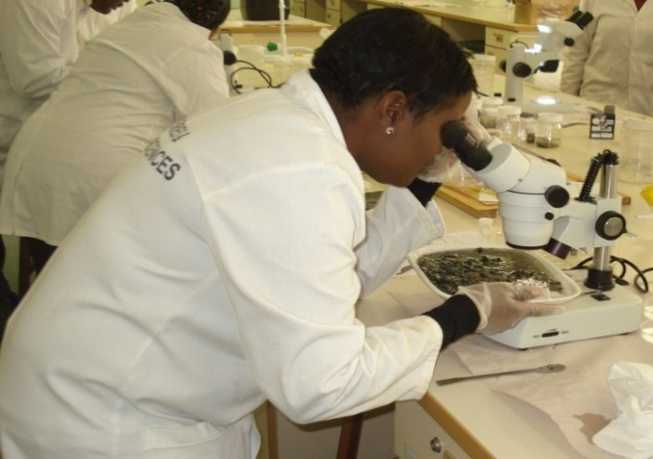
Research: Benthic monitoring programme
Van Veen Grab
Collection of identified
samples
Research platform
Sieving samples
Identifying
organisms
Analysing differences in seabed
communities between sampling
Sites.
Removing organisms from samples

Slide 16
Current challenges
EMS integration
Reworking all documentation – environmental component;
Transition – incorporate ISO14001: 2015
Increase involvement of the leadership team
Improves:
  environmental performance (vs conformance), reducing waste and preserving natural resources
  Risk and opportunity management ensuring continusl improvement is systematic
  Lifecycle management
  Corporate responsibility to meet your supply schain requirements
  More ifficient processes
Training, awareness
implementation
Readiness ness for Rectification audit - 2018

Slide 17
Improvement opportunities: Assurance
Vessel Inspections
Audits
  internal Audits
  Accredited External Audits
  Cross audits
  Specific audits (waste, legal, ems)
Annual Management Review

Slide 18
Success stories
Certified since 2002
Successful Recertification Audit 2015
EIA and EMP approved by DEA. Environmental Clearance Certificate renewed, valid for 3 years (22ndJan 2016 – 22ndJan 2019)
Training: ISO 14001:2015 (Transition, Implementation & Leadership)
Closure Plan review and gap analysis workshop
Successful execution of the 2016 annual benthic sampling campaign
Operational assurance vessel visits to support, assist and provide guidance on environmental management on board the vessels.
Publication of scientific work done
Transition to ISO 14001:2015

Slide 19
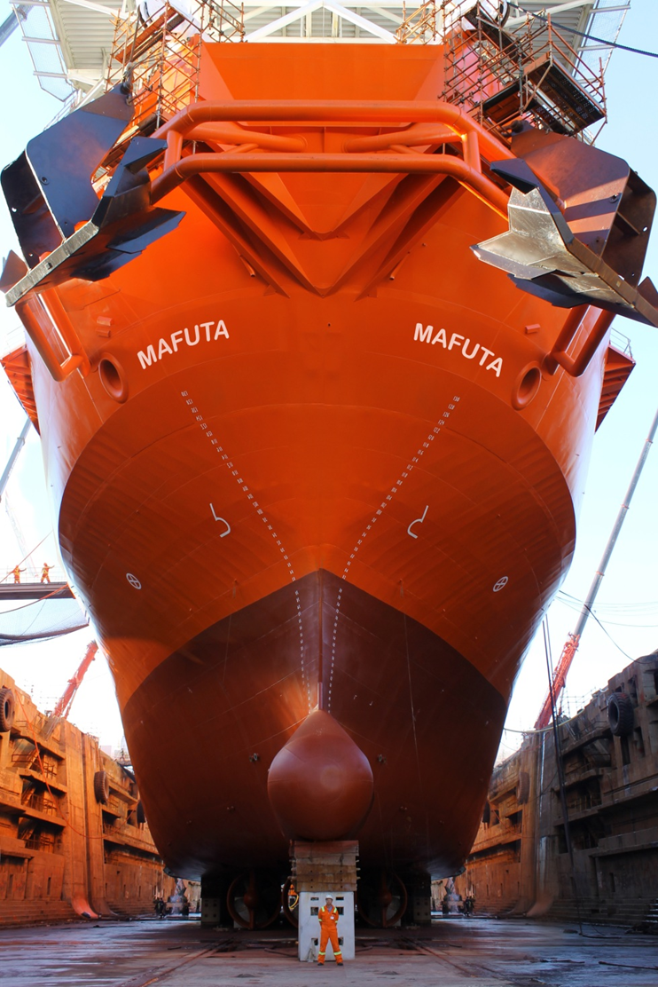
Thank You

