Slide 1
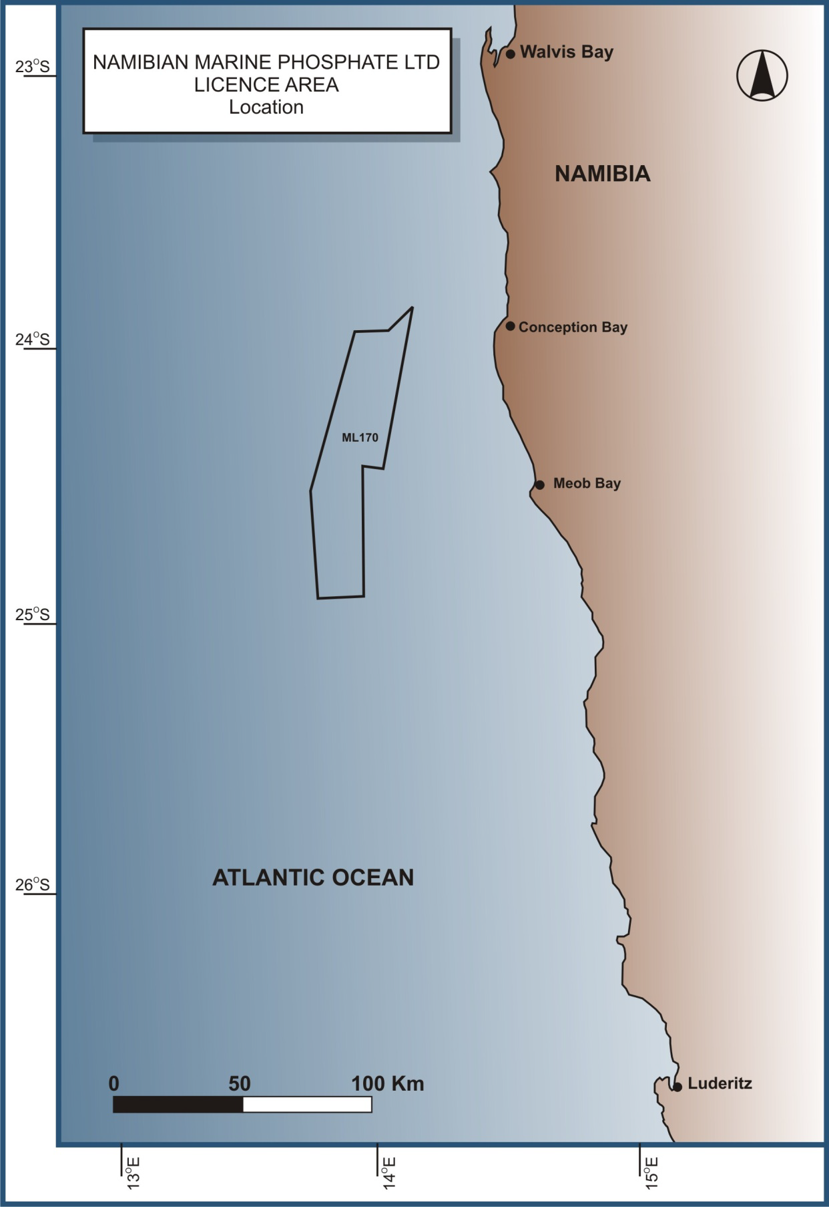
Namibia Marine Phosphates
The EIA process, findings and reaching a sensible decision
Chris Brown (NCE)
John Pallett (NEWS)
Peter Tarr (SAIEA)

Slide 2
Marine phosphate mining
Why this event?
Considerable public interest
Potentially important new industry, but risks
Lots of opinions, distortion of facts, jurisdictional conflicts
Polarised viewpoints – personal biases
Difficult decision (legitimate concerns)
Ideas for strengthening systemic weaknesses in managing Namibia’s EIA process.

Slide 3
Marine phosphate mining
Global overview of seabed mining
What is EIA?
Understanding and managing impacts
“Namibia Marine Phosphate” process so far
What did the EIA say?
Critique of the NMP process
What does the Environmental Clearance say?
What could be a sensible decision?
Broader recommendations for EIA in Namibia
Discussion

Slide 4
Global overview
Currently 25 exploration contracts approved by ISA (UNCLOS) :
  4 for cobalt-rich crusts in the South Atlantic and Mid-Pacific
  16 for manganese nodules in the Pacific and Indian Ocean;
  5 for SMS (sulphides) in Indian Ocean and Mid-Atlantic Ridge.
Commercial interest in deep-seabed minerals within national jurisdictions, including in the Pacific Islands region, Mexico, Namibia, New Zealand, Saudi Arabia, South Africa, and Sudan.
Deep-seabed mineral exploration licenses issued for SMS by Fiji (1) Papua New Guinea (2) Solomon Islands (3) and Tonga (4).
Marine diamond mining in Namibia and RSA for decades.

Slide 5
Big new project – good or bad?
What are the benefits, and to whom?
What are the costs, and who pays?
  Ecosystem, ecosystem services, biodiversity
  Society, including local communities
  Economic sectors and national economy
The best, most internationally recognised and constantly improving tool we have to help assess a project is EIA

Slide 6
Introduction to EIA

Slide 7
What is EIA?
A process of identifying, predicting and evaluating the biophysical, social and other relevant effects on the environment of activities prior to their
authorisation with a view to avoiding or minimising negative impacts and enhancing the positive.

Slide 8
EIA is NOT
A decision making tool – it is decision aiding
The only information used by decision makers
An exact science – many limitations
A confidential process
Legally-binding
The last word.

Slide 9
EIA process
Development concept
Screening
Feedback
Initial Terms of Reference prepared
Proponent/Authorities/Consultants
Authority review and approval
Scoping study
Revised ToR for EIA and specialist studies. EIA commences
Public input
EIA and EMP report

Slide 10
Assessing and mitigating impacts

Slide 11
The challenge is determining:
Spatial extent of impacts (local, national, regional, global)
Duration (short, medium, long term)
Significance (how serious?)
Probability of the impact happening
Cumulative impacts
Avoidance, mitigation, recoverability.

Slide 12

Bottom line: who wins, who loses?
The win:win solution is the one where the impacts on the environment are the least, the benefits to society are greatest and the technical costs are lowest…
…Is this possible?

Slide 13
Mitigation hierarchy
Option Criteria
Common,
preferable
Rare, undesirable
Preferred option will result in significant impacts – requires major re-design
Preferred option is acceptable but there is considerable scope for better within-project alternatives
No viable alternatives to the preferred option, but impact avoidance or minimization is impossible.
Avoidance
Minimization
or remedy
Alternative sites or technology to eliminate Impacts
Actions during design, construction, operation to minimize or eliminate impacts
Used as a last resort
to offset impacts
Compensation
or offsets

Slide 14
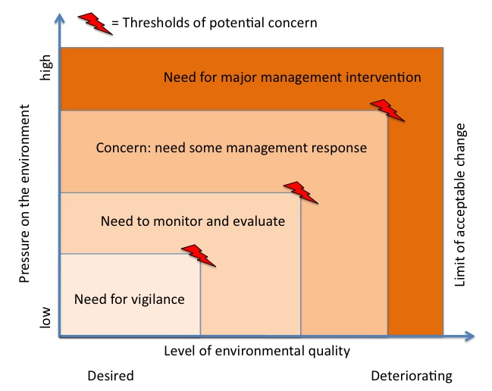
Framework for impact management

Slide 15
NMP EIA process so far

Slide 16
Date | Action | Comments
Nov ‘10 | Prefeasibility study | Done before EIA scoping
Dec ‘10 | Register EIA with MET
July ‘11 | ML170 granted by MME | ML granted before any public consultation, conditional on EIA
Sept ‘11 | Public consultation (scoping) | Some meetings held – WHK, Swakop, WB + focus groups
Oct ‘11 | Bulk sampling completed | Unfortunately no monitoring done – missed opportunity
Nov ‘11 | Draft scoping report (marine) submitted to MET (open for comments) | Public had 11 working days to review. In line with Namibian legislation but inadequate given the fact that the project is a first of its kind in the world.
Nov ‘11 | Register EIA for terrestrial component | EIAs split and not synchronised
Jan ‘12 | EIA and EMP completed (open for comments) | 4-5 weeks after scoping. Specialists maybe unable to address issues raised by I&APs. Public given 15 working days to comment (legally compliant, but short).
Jan ‘12 | Commencement of EMA, (7/2007), publication of EIA regulations. | EIA process almost complete by the time the EMA and EIA regulations were gazetted.
Mar ‘12 | Final EIA + EMP report to MET | Internally reviewed by the CSIR
Mar ‘12 | Completion of feasibility study | Feasibility and EIA correctly synchronised
Feb ‘13 | External review of EIA | Commissioned by MET, done by SAIEA. Some aspects of the EIA inadequate, others good. Verification studies recommended
Sept ‘13 | Phosphate mining moratorium | Time frame 18 months
Nov ‘14 | Verification studies completed | EIA + studies = comprehensive analysis, but limitations
Sept ‘16 | Clearance issued | Subsequently withdrawn pending consultations.

Slide 17
What the EIA says
There are presently no identified issues of environmental significance to preclude the dredging of phosphate-enriched sediments from the Mining Licence Area No. 170.
There are however, management and mitigation measures that are to be implemented by NMP and their sub contractors.

Slide 18
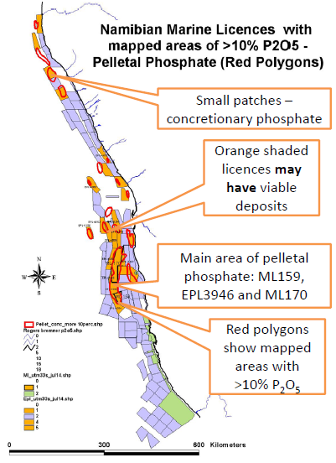
NMP Verification Study findings
  Known commercially viable phosphate deposits cover 0,5% of Namibia’s EEZ
  NMP intend to dredge = 3 km² per year (0,0003% of EEZ), 60 km² over 20-years.
  Flat, smooth seafloor, homogeneous sediment, no protruding rocks or reefs

Slide 19
NMP Verification Study findings
In situ sampling, complemented by
laboratory analyses
Fisheries and Biodiversity study
  Hake and monk-fish - No spawning or
  recruitment in ML170
  A very small direct impact on hake and monk relative to their overall abundance in Namibian waters
  Animals such as sea-squirts, brown sponges, sea pens, shrimps, starfish, whelks and worms live in the mud. No site-specific or threatened species of fauna in the mining area.

Slide 20
NMP Verification Study findings
Water column and sediments
  Heavy metal concentrations in the sediments relatively high: - arsenic, cadmium, chromium, copper, nickel. But, the release of metals into the water is low because they are contained within the phosphorous granules.
  Trawling for fish has resulted in plumes and the release of these metals into the water column for many decades (Nam fish exported to EU).
  Trophic transfer of heavy metals – uptake by plankton. Will not be passed up the food chain.

Slide 21
NMP Verification Study findings
Ecosystem
  No unique features in ML170
  The area of impact is so small relative to the overall extent of the continental shelf and the Benguela ecosystem that significant impacts on the ecosystem are unlikely

Slide 22
NMP Verification Study
Conclusion
Sea-floor mining at ML170 will not significantly harm Namibia’s marine environment or the fishing industry
“There are no objective scientific reasons why an Environmental Clearance Certificate should not be issued and the project permitted to proceed”

Slide 23
Critique of the EIA process
Poor public consultation after original EIA in 2011. All correspondence with I&APs stopped.
Splitting of the EIA into marine and terrestrial components
  Suspicious of “divide and rule”
  Possibly justified in view of the possible discontinuation of the project if marine operations not allowed.
  But may compromise the decision on the terrestrial EIA.

Slide 24
The Environmental Clearance Certificate was issued subject to the following conditions:
Clearance to proceed is valid for a period of three (3) years.
If impacts are found to be greater than expected, and no feasible and acceptable mitigation measures are implemented, then the operation shall be closed and the Environmental Clearance Certificate withdrawn.
Bi-annual (twice per year) reports on the implementation of the Management Plan (and the monitoring required therein) must be presented to both the Ministry of Environment and Tourism (MET) and to the Ministry of Fisheries and Marine Resources (MFMR).
Dredged seabed and water column monitoring must be conducted on a regular basis with reports submitted to MET quarterly.

Slide 25
Conditions continued …
The proponent must fund the establishment of a “centre of excellence” to monitoring the impact of phosphate mining and to produce generic standards and guidelines for the sector in future.
Data from the monitoring must be freely shared with the competent authorities.
The best available technology must be used to have least environmental impact.
The mining and processing techniques will be reviewed annually against monitoring data, to be done jointly by the proponent and the regulator.
Separate environmental clearance must be obtained for the onshore processing plant.

Slide 26
Are the conditions sufficient?
The marine phosphate mining Environmental Clearance Certificate should be made conditional on the land-based EIA also getting an ECC – and that the two components are seamless.
An independent Committee should be established to oversee the monitoring process, to receive results and reports, to evaluate impacts and adaptive management and to advise the Office of the Environmental Commissioner on two vital aspects:
  To withdraw the ECC should impacts be greater than anticipated and detrimental to the Marine ecosystem, and
  Should impacts be minimal, as expected by the respective specialists, how should mining be managed to avoid unacceptable cumulative impacts, and what ongoing monitoring should be done?

Slide 27
Strengthening conditions …
The above Committee should oversee the establishment of an independent monitoring group and the development of a comprehensive monitoring plan.
The Committee should oversee the revision of the Environmental Management Plan and its implementation.
A public domain website should be established by the Committee on which all monitoring data & reports are posted, as well as proceedings of their meetings.

Slide 28
Broader recommendations for EIA management in Namibia

Slide 29
Why this level of conflict?
It’s the process, not the contents of the EIA!
Public consultations
  Not enough to hold a few public meetings early in process & place EIA docs on website
  Must be a process of engagement
Decision-making
  Should not be left to one official (too much responsibility and heat)
  The Sustainable Development Advisory Council (SDAC - 4 GRN 4 non-GRN members) should give recommendations.

Slide 30
One size does not fit all
  For large and potentially controversial projects, design the process appropriately
  The SDAC should work with the Office of the Environmental Commissioned to develop a project road map which includes a process of public engagement
Access to information
  All EIAs and EMPs and public engagement reports should be in public domain – easily accessible, on one GRN website (and never taken down)
  Project’s timelines and events should be on the website
  All decisions should be on the website.

Slide 31
Accountability by EIA practitioners
  Need for professional body (e.g. EAPAN) under an Act that required professional standards
  allows for disciplinary action
These actions would significantly improve EIA processes in Namibia, particularly for large, difficult projects.
Final thought: being pro-environment does not mean being anti-development. Each project must be weighed up (costs & benefits) on its merits. Anti-development without merit is stupid and has no credibility. It undermines the case for when a real stand needs to be taken for the environment.

Slide 32
Thanks you
Discussion

