Slide 1
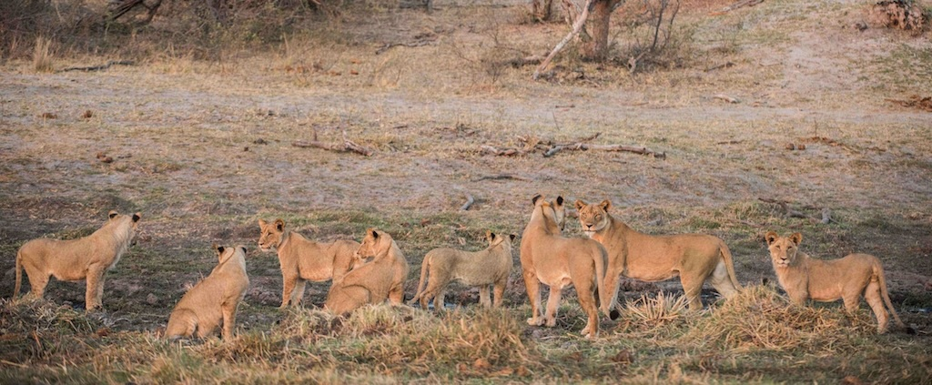
Lion (Panthera leo)
Species status assessment compiled by
Stéphanie Périquet (CCF) & Lise Hanssen (Kwando Carnivore Project)

Slide 2
Global assessment
IUCN Namibia Threats Actions Sources
Population trend: DECREASING

Slide 3
Southern Africa
IUCN Namibia Threats Actions Sources

Slide 4
Namibia
IUCN Namibia Threats Actions Sources
Etosha – 450 (Piet Beytell; Michelle Moeller – Call up surveys; GPS collars)
Etosha heights, Ongumu, Ongava – 100 (Piet Beytell)
Bwabwata NP – 23 (Lise Hanssen – Spoor surveys, GPS collars, Observations)
Mudumu NP/Nkasa Rupara/Mudumu Complex - 21 (Lise Hanssen – GPS collars, camera trap, long-term monitoring)
Khaudum/Nyae Nyae – 37 (Piet Beytell – Call up surveys; GPS collars)
Kunene – 150 (Flip Stander – long term study)
We know pride structure and current ages for all lions in the NE and NW.

Slide 5
Threats
IUCN Namibia Threats Actions Sources
Retaliatory persecution for human-wildlife conflict
Problem animal trophy hunting (NE and NW)
Road mortality
Illegal trade in body parts (Emerging in the NE)
Habitat destruction/declining connectivity (North East)
Poisoning

Slide 6
Actions
IUCN Namibia Threats Actions Sources
Human-Lion conflict mitigation efforts
Traffic slowing in road mortality hotspots (often shared by other species like wild dogs).
Revisit the zonation layout for the Zambezi Region conservancies
Adhering to zonation and land use (Human settlement).
Stop the legal and illegal timber harvesting in the State Forest (Zambezi Region)
Trophy hunting should not be used as problem solver (NE and NW)
Education and information to law enforcers on harvesting of lion body parts.

Slide 7
Sources
IUCN Namibia Threats Actions Sources
IUCN Red List
Lise Hanssen (GPS collars, spoor surveys, camera trap surveys)
Piet Beytell (GPS collars, spoor surveys, camera trap survey in process)
Michelle Moeller (GPS collars, surveys)
Flip Stander (Long-term study)

