Slide 1
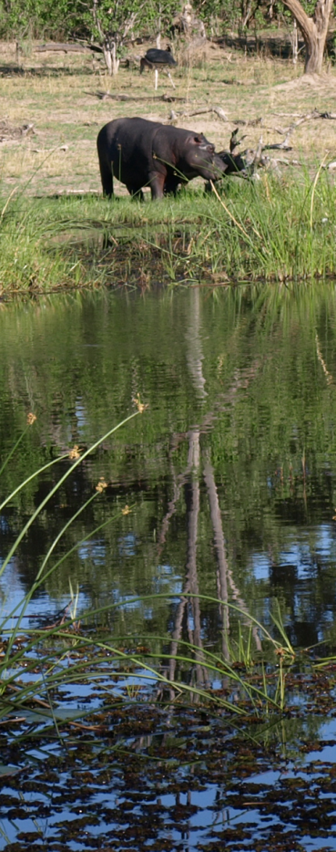
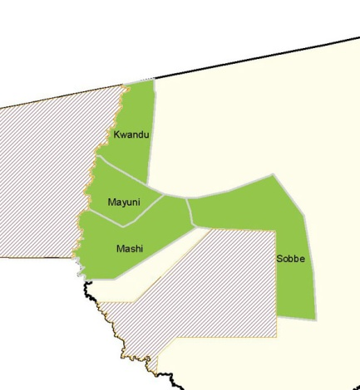
Annual Natural Resource Report
Wildlife Trends
Game counts
Wildlife Populations
Data from monthly fixed foot patrols. Index calculated as number of sightings per patrol.
Sightings
Estimates
Sightings are animals seen in the conservancy during the annual game count. Estimates are for the local area and include Kwandu, Mashi, Mayuni & Sobbe.
Species | Animals seen
Duiker | 4
Impala | 12
Kudu | 4
Lechwe | 5
Warthog | 2
Species | Likely estimate
Duiker | 1239
Kudu | 604
Photo: S. Mayes
Photo: S. Linder
Photo: A. Symonds
Predator sightings
Photo: M. Jarvis
Index calculated as number of sightings per event book.
Locally rare species
Mortalities
Environmental monitoring
Species | Animals seen
Eland | 46
Ground Hornbill | 18
Impala | 618
Lechwe | 13
Reedbuck | 2
Roan | 30
Wild dog | 1
Species | Animals dead
Hippopotamus | 1
Impala | 1
Vegetation
Pie indicates change in bush cover between 2007 and 2009
Locally rare species are those which are currently infrequently observed in the conservancy
Mortalities are animals found dead during patrols and opportunistic sightings
Kwandu

Slide 2
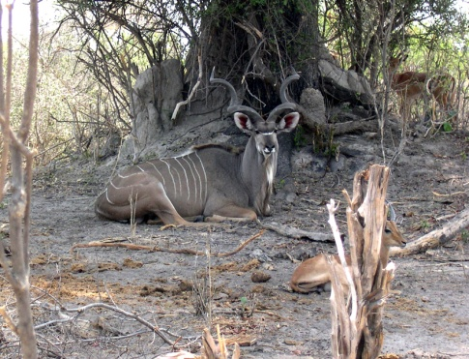
Kwandu - 2009
Wildlife Use
Wildlife Income
Species | Quota | Type of Utilisation |  |  |  |  |  | Total used
 |  | Own Use | Trophy | Capture | Shoot & Sell | Traditional | Problem animal
Elephant | 4 | 1 | 1 |  |  |  |  | 2
Hippo | 3 | 1 | 1 |  |  |  | 1 | 3
Crocodile | 2 |  |  |  |  |  |  | 0
Lechwe | 4 |  | 1 |  |  |  |  | 1
Impala | 3 | 1 |  |  |  |  |  | 1
Bush pig | 6 |  |  |  |  |  |  | 0
Kudu | 2 |  |  |  |  |  |  | 0
Hyaena | 1 |  |  |  |  |  |  | 0
Leopard | 1 |  | 1 |  |  |  |  | 1
Duiker | 5 |  |  |  |  |  |  | 0
Reedbuck | 1 |  |  |  |  |  |  | 0
Wildlife Introductions
Year | Species | Number
2007 | Impala | 40
Photo: T. Robertson
Natural Resource Management
Threats
Poaching
Performance:
Weak Good
Human-Wildlife Conflict
Incidents
Incidents
Species | 2001 | 2002 | 2003 | 2004 | 2005 | 2006 | 2007 | 2008 | 2009
Baboon |  |  | 56 | 23 | 29 | 56 | 14 | 10 | 5
Cheetah |  |  |  |  |  | 1
Crocodile | 2 | 5 | 10 | 14 | 11 | 9 | 3 | 5 | 11
Elephant | 159 | 227 | 111 | 140 | 184 | 214 | 321 | 183 | 173
Hippo | 33 | 77 | 82 | 31 | 78 | 155 | 6 | 11 | 16
Hyaena | 25 | 4 | 2 | 15 | 5 |  | 1
Jackal |  |  | 38 | 8 |  |  | 6 | 4 | 8
Leopard | 3 | 2 | 1 | 7 | 13 | 8 | 5 | 1 | 9
Lion | 8 | 26 | 11 | 6 | 1 |  | 1
Pigs |  |  | 142 | 151 | 156 | 217 | 112 | 210 | 182
Porcupine |  |  | 29 | 16 | 42 | 18 |  | 3 | 2
Species 2009
Red bars indicate weak areas in the conservancy management performance which need to be addressed. Green bars indicate positive management performance.
Effort:
Number of Community Game Guards: | 13
Rainfall (mm)
Damage
The species chart indicates the most troublesome to least troublesome conflict species in the conservancy. The Y-axis in HWC and poaching charts represents number of incidents.
Years with no bars indicate gaps in data collection
Kwandu

