Slide 1
Environmental Management
Otjikoto Gold Mine
June 2017
Environmental Committee – Chamber of Mines
Angie Kanandjembo

Slide 2
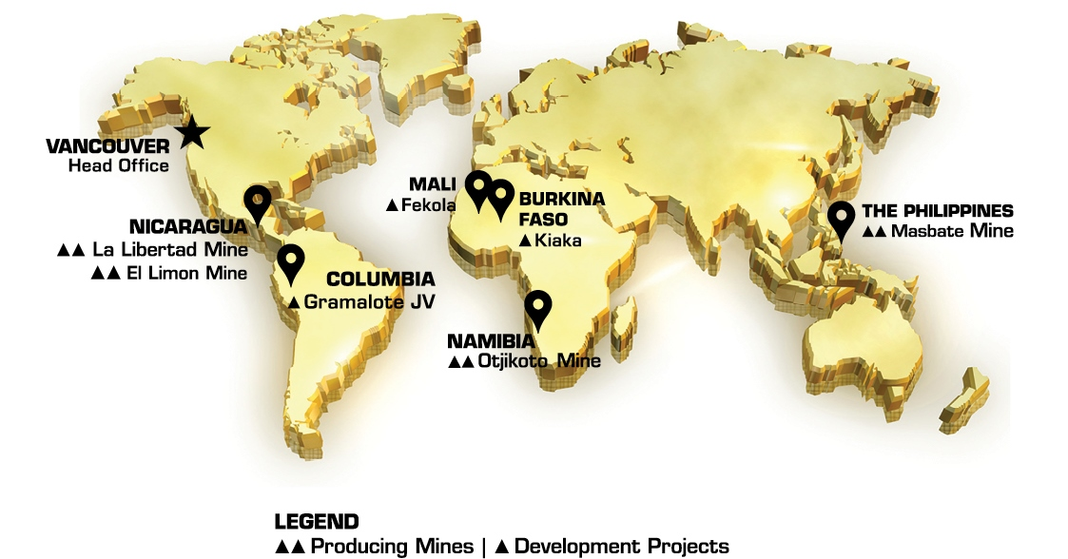
Background – B2Gold Corporation

Slide 3
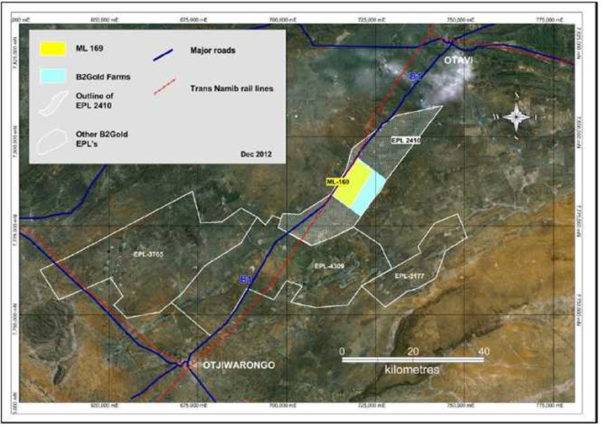
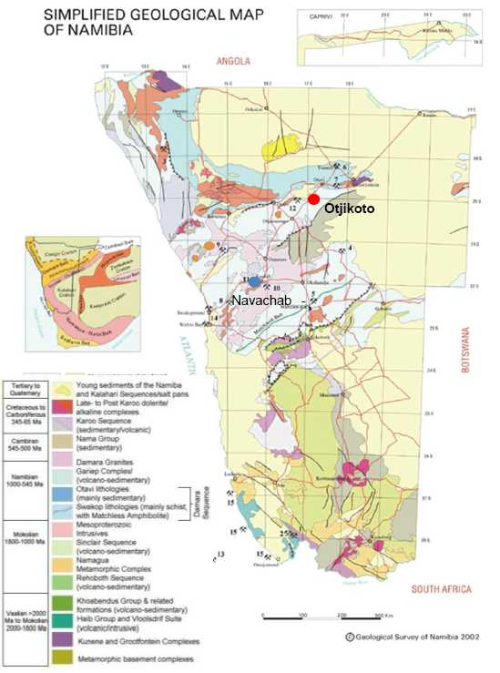
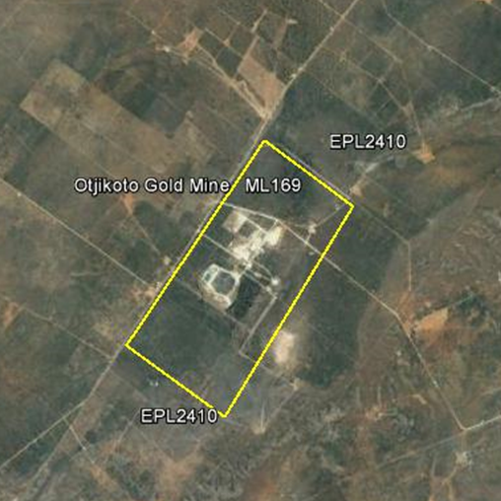
Location of Otjikoto Gold Mine

Slide 4
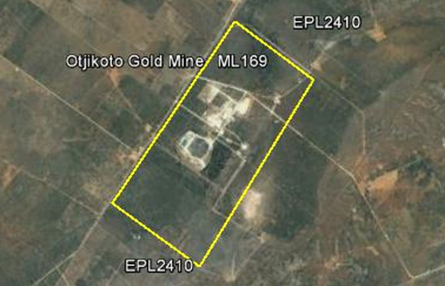
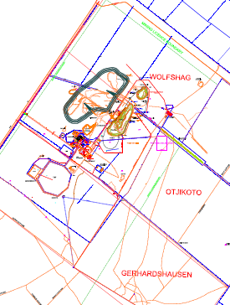
Background – Otjikoto Gold Mine
Project cycle
Exploration ex 1980’s
Gold Discovery 1997
ESIA – 2010-2013
Construction 2013-2014
Operations 2015
Operations
Conventional open pit mining
Drill, blast, haul, load – WRD & ROM
Metallurgical process
Crush, mill, leach, adsorption, elution, electro-wining, regeneration and smelting – Gold bullion and waste to lined TSF.

Slide 5
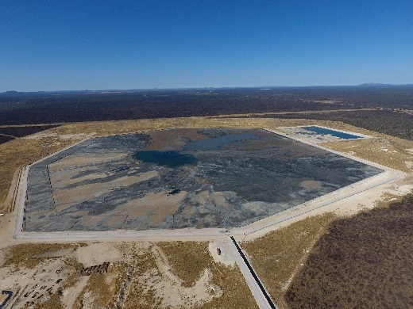
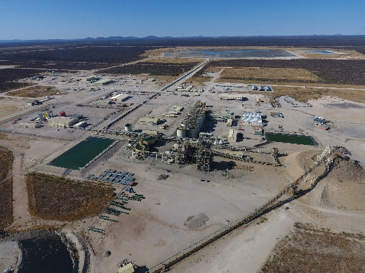
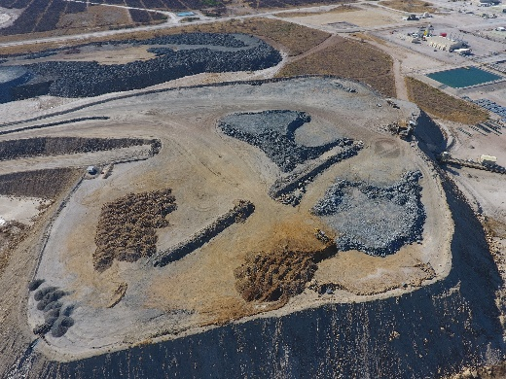
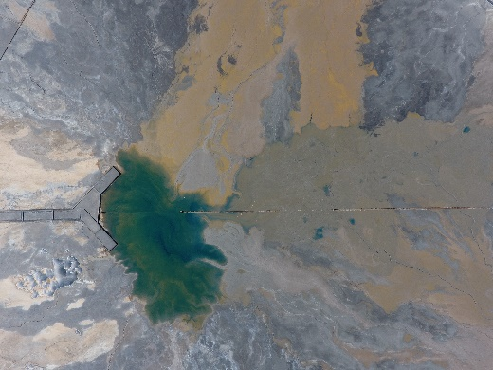
OGM - Environmental Department
Manager
Risk management
Compliance management
Specialist
EMS implementation
EMP/EB standards implementation
Officer
Aspect technical/EMS monitoring
Data, records, CA – coordination/Management
Support staff x 6
Daily operational support services

Slide 6
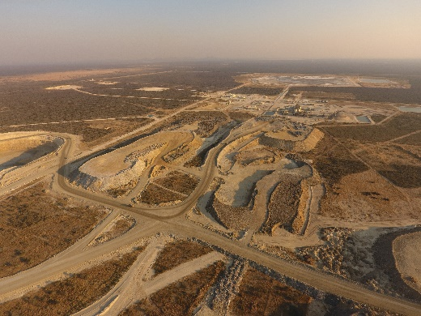
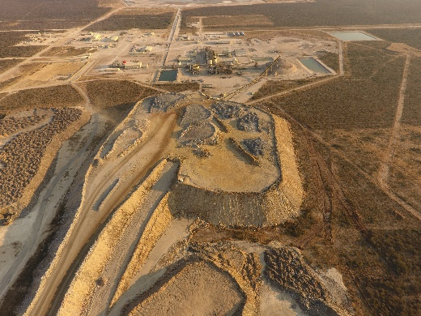
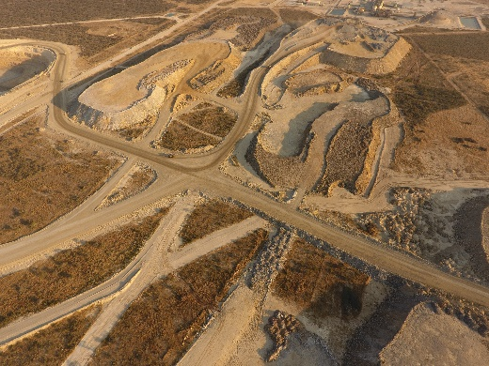
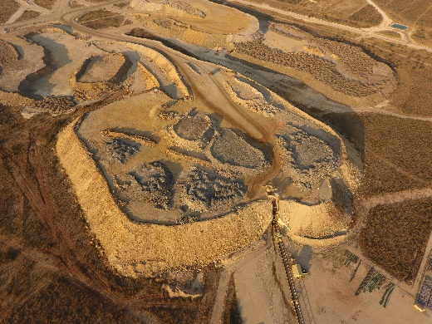
OGM - Environmental Department
Ensure responsible mining by managing environmental risks
Legislation
Compliance
Maintain standards
Engage/inform key stakeholders
Shareholder/investor expectations
Reduce liability
Prevent reputational risk

Slide 7
Challenges
Internal –
Lack of understanding re Environmental management, commitments and accountability
Short term thinking vs long-term changes / planning
Poor planning/design/engineering
Late involvement of Environmental department in key projects or changes in products, services, processes
Work force – awareness/understanding of expectations
Inadequate budget relevant to the risks being managed
Decisions on managing critical environmental aspects slow

Slide 8
Challenges
External –
Lack of critical legislation and standards in the industry on key environmental aspects
Delays in permissions/approvals/decisions by GRN
GRN understanding of industry/business
Piece-meal approach to projects key/core to the business (e.g. multiple ECCs for one operation)
Public awareness and understanding
Lack of interaction with Environmental peers in the industry
Limited experience and capacity in Environmental Management in the sector (practical know-how)

Slide 9
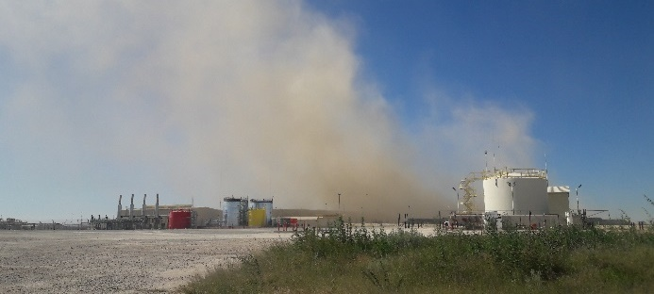
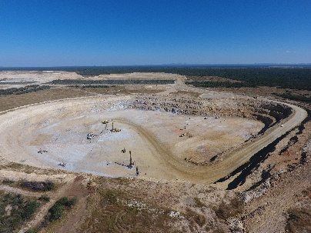
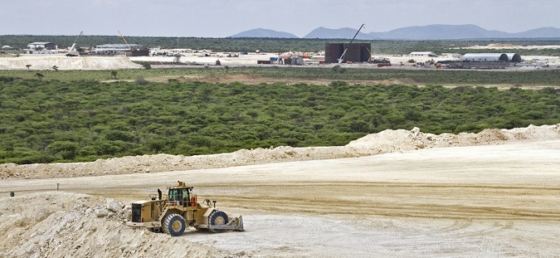
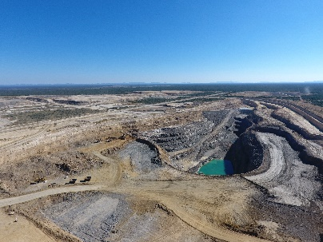
On the path to Success
Meeting expectations of our shareholders in terms of standards set
Self – regulatory/compliance and enforcement - to maintain compliance
HSEMS - Environmental improvement plans to commit to achieve on critical risks
Alternative management of (!) hazardous waste – treatment onsite
Extensive groundwater monitoring network within neighbouring farming community
Reduce our carbon footprint by phasing into Solar energy
Collaborating with NUST on rehabilitation programmes
Partnership with Governors waste management initiative for Otjozondjupa region
Enhancing the Farmers association gathering into full stakeholder engagement sessions

Slide 10
What could be done?
Invest in environmental management to improve performance
Develop critical legislation
Enforce the laws
Proactive engagement with all stakeholders
Establish partnerships
Networking, knowledge sharing/collaboration
Benchmarking - comparatively
Provide environmental management peer support in the industry

Slide 11
Strategic Plan for E-COM
Influence and contribute to development of critical legislation to support the industry
Improve GRN understanding of the industry / business
Enforcement of and Compliance to law
Joint capacity building with GRN to support industry
Proactive engagement with GRN
Partnerships - Educational and research institutions
Support services – e.g accredited laboratories
Support CSR initiatives that can enhance / support environmental management within the industry
Align Strategy with Harambee Prosperity Plan

