Slide 1
Conservation Agriculture in Caprivi Region
Presented by Tererai Msakwa Namibia Nature Foundation Project coordinator Caprivi

Slide 2
NNF activities in Caprivi
Conservation farming- Market linkages
Agroforestry-Value addition- Mungongo oil, JamBeekeeping
Chili and gardening
Fish farming
Poultry

Slide 3
Stakeholders
MAWF
CEDP
MET
IRDNC
DOF

Slide 4
Conservation farming
Background- Population
According to the 2001 statistics
Females 40,749
Males 39,077
Total population size 79,826
In urban areas 28%
In rural area 72%

Slide 5
Farming activities
Drought prone area with erratic rainfall that rarely exceeds 500mm per annum
Floods
72% of the rural population mainly subsistence farming using conventional methods.
Mainly fed through government aid since independence heavy reliance on aid

Slide 6
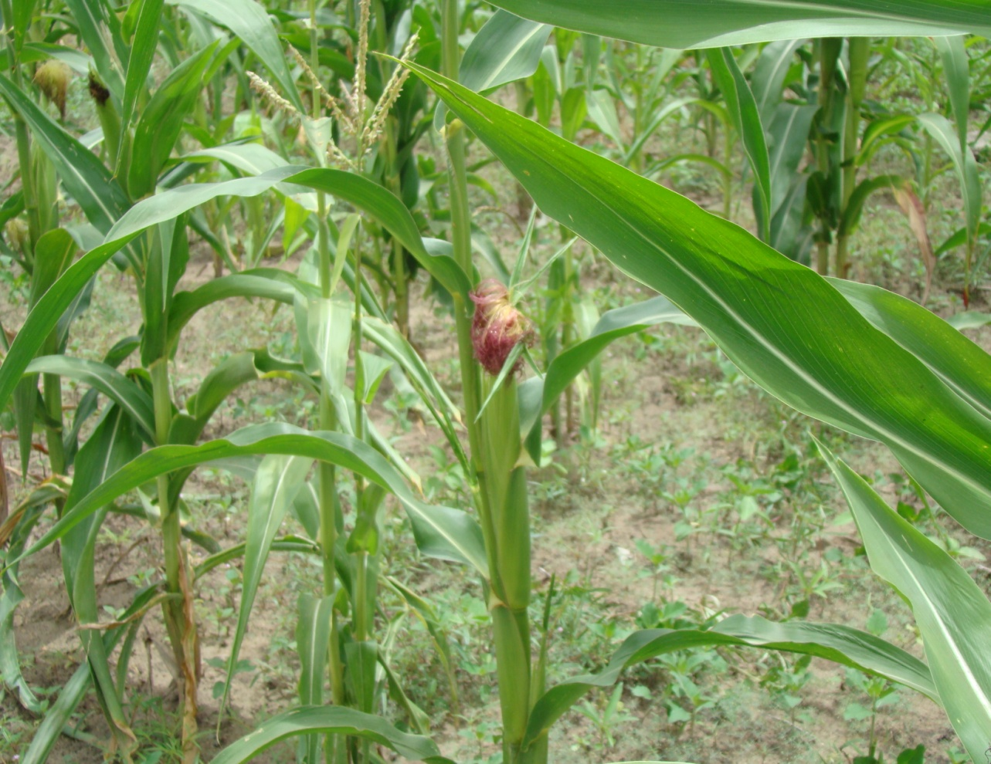
Subsistence farming results
Poor yield less than 1 tonnes on average 500kg per year

Slide 7
Why CA in caprivi
The need to produce better quantities- Food security
Soil conservation and land management

Slide 8
Introduction of CA to Caprivi
2005/2006 under CEDP , CEE( WWF, USAID)
CF system TOT farmer to farmer extension
Area coordinators – Facilitators, Trainer – LCF- CF- Farmers
Total farmers under this programme( see attachment)

Slide 9
CPP funded from 2009 under NNF administration
Farmers adapted and in centres
9.4 Ha under 125 farmers in 2011 ripper and hoe
Current recruitment 23 ha and 311 farmers ripper and hoe

Slide 10
Principles of CA
Early land preparation
Semi - Permanent planting stations
Precise placement of seeds/manure or intercropping
Crop residues
Frequent weeding
Crop rotation

Slide 11
Ripper method

Slide 12
Ox drawn Ripper

Slide 13
Land Preparation By ripper

Slide 14
Land preparations by Hoe method

Slide 15
Results For Ca in Pictures

Slide 16
Information dissemination Field days

Slide 17
Field days

Slide 18
Field days

Slide 19
Field days

Slide 20
Field days

Slide 21
Yields under CA
Please see attachment

Slide 22
Challenges for Caprivi
CA hoe
CA Ripper
Own Farm Adaptation

Slide 23
Way forward
Expand CA activities in Caprivi
Scale up adoption of CA in own farms (25m by 50m to 50m by 50m)
Promote intercropping of cover crops (legumes)
Market linkages

Slide 24
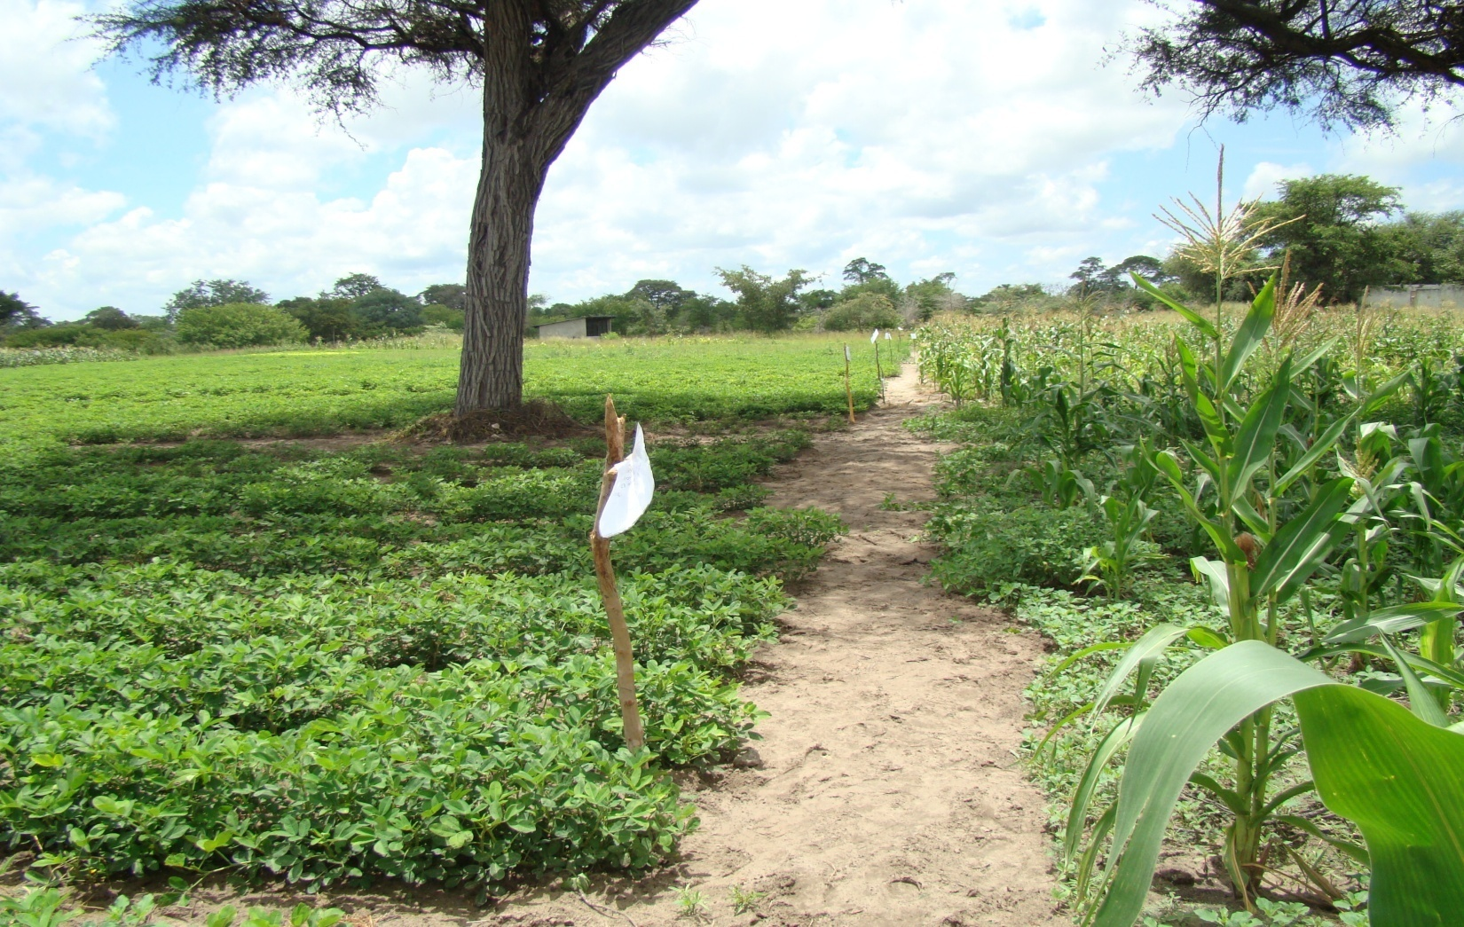
Thank you

